Slide 1
Primary Care Performance Measurement and Reporting
Findings and relevance to health policy development
Fred Burge for: Sabrina Wong, Sharon Johnston, William Hogg, Ruth Martin-Misener, Jeannie Haggerty, Emily Marshall
Nova Scotia extended team: Rick Gibson, Tara Sampalli, Lynn Edwards
March 7, 2018 Evidence Roundup
MEASURING AND IMPROVING THE PERFORMANCE OF PRIMARY HEALTH CARE IN CANADA

Slide 3



Local supportive and integrated organizations

Slide 4
Issue:
Primary care performance measurement and reporting framework needed to advance this health sector
Significant investments in different approaches to improving primary care over the past 10-15 years
Need for comprehensive performance measurement and reporting on these investments for system learning and accountability
TRANSFORMATION Study
Aim: to advance the mechanisms for regional-level primary care performance measurement and reporting
Study regions: Fraser East, BC; Eastern Ontario Health Unit, ON; Central Zone, NS

Slide 5
TRANSFORMATION
Four interrelated studies:
Compare measures of CBPHC performance and healthcare equity between regions, including comparative performance for complex vulnerable patients;
Examine contextual factors that may explain regional variation;
Develop and evaluate an approach to national reporting of CBPHC performance based on priorities and optimal reporting formats;
Identify innovations of service delivery associated with better CBPHC performance and healthcare equity;

Slide 6
Our data sources
Data sources
Quantitative Data,
Performance as organized by the Patient’s Medical Home Model (aka ‘health home’ in NS)
Practice survey data from:
Patients
Clinicians
Organizational leads
Practice team members
Health administrative data,
Quality indicators of:
Technical quality of care
Continuity
Health service utilization
Primary Care Performance Portrait
Qualitative Data
Data on regional context from case studies
What primary care policies / innovations / strategies have been adopted in each of the three study regions?
Data on performance reporting from patient-citizen dialogues
What performance information should be publicly reported? Uses? Formats?

Slide 7
Portrait of Performance in Primary Care
Create regional level performance portraits using case study, survey, administrative data

Slide 8


What does it mean to be a health home?
  Person– and family- centred
  Timely access
  Every patient has a most responsible provider
  Comprehensive scope of services carried out by teams or networks of providers
  Continuity and coordination of relationships, & information
  Ideal sites for training and research
  Electronic medical records (EMR)
  Commitment to continuous quality improvement and safety
  Strongly supported by governance structures, practice management, the public, etc.
  Health homes work in collaboration with other health homes to foster collaboration
  Adapted from: A Vision for Canada: Family Practice - The Patient's Medical Home (College of Family Physicians of Canada, 2011)

Slide 9
Construction of patient reported dimensions of primary care performance
Iterative, theory-driven process
Simplify reporting of a large patient survey dataset
Seven patient reported dimensions of primary care performance:
  Accessibility orientation
  Relationship based care
  Promoting health
  Self management support
  Coordination orientation
  Safe care
  Equity orientation

Slide 10
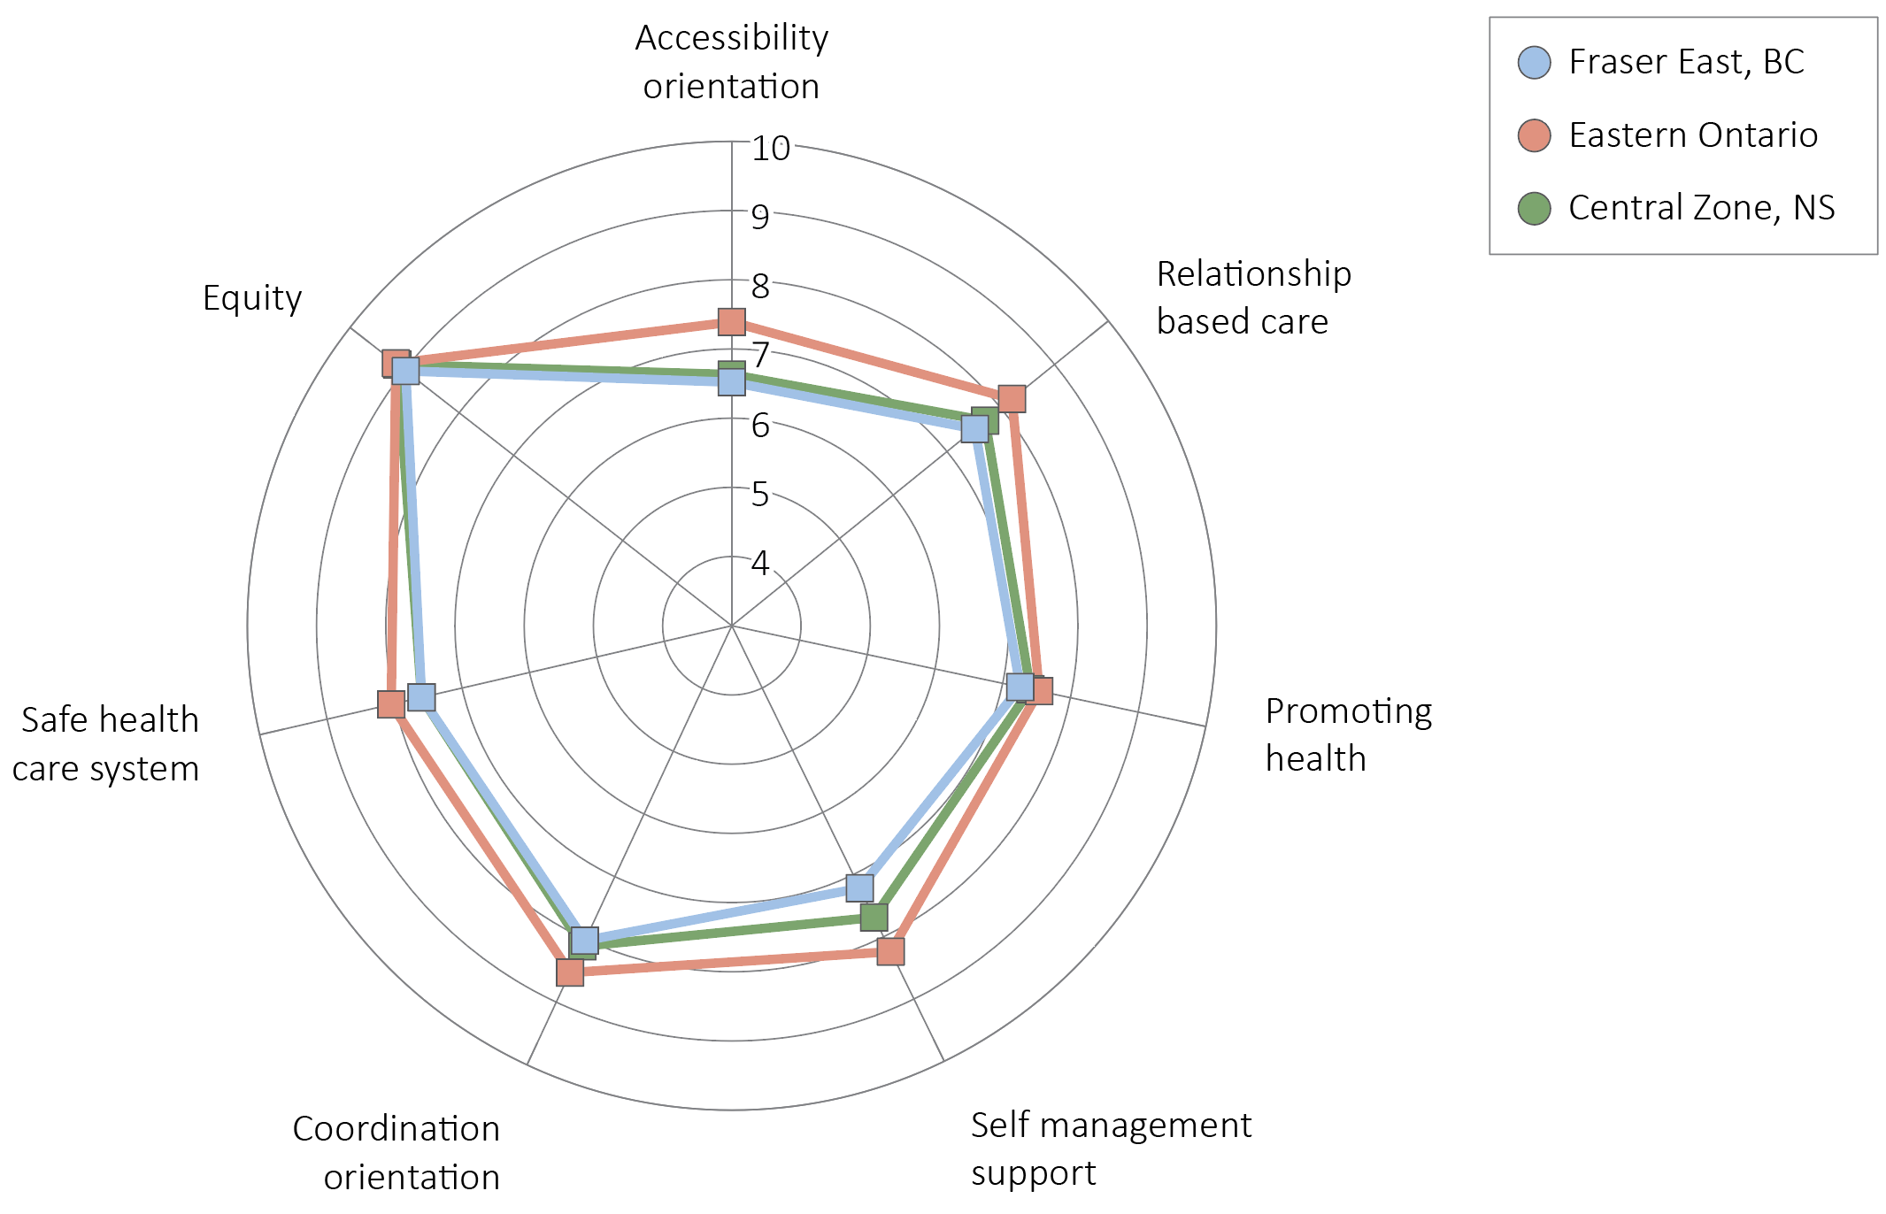
Mean clinic scores, by dimension and region
Notes:
Radar graph option

Slide 11
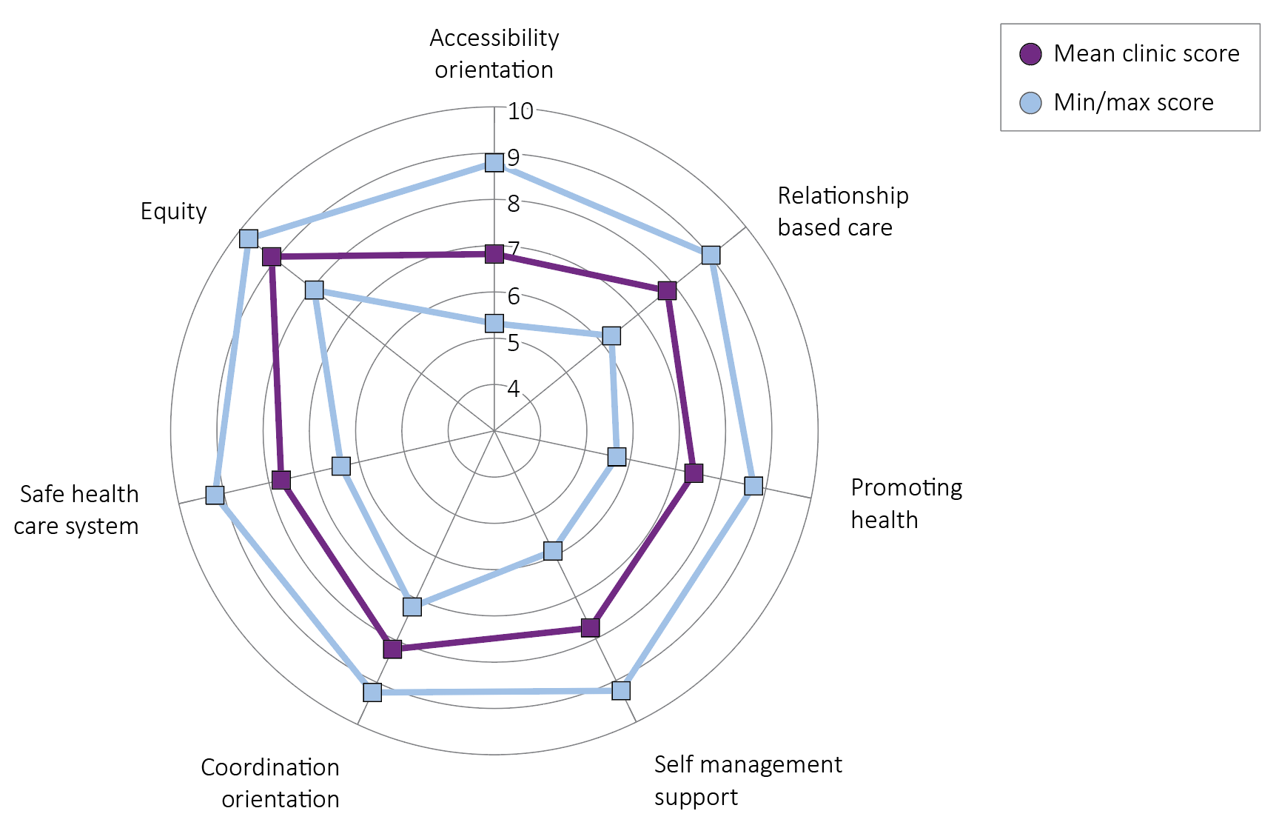
Mean, min and max clinic scores, by dimension
Notes:
Radar graph option

Slide 12
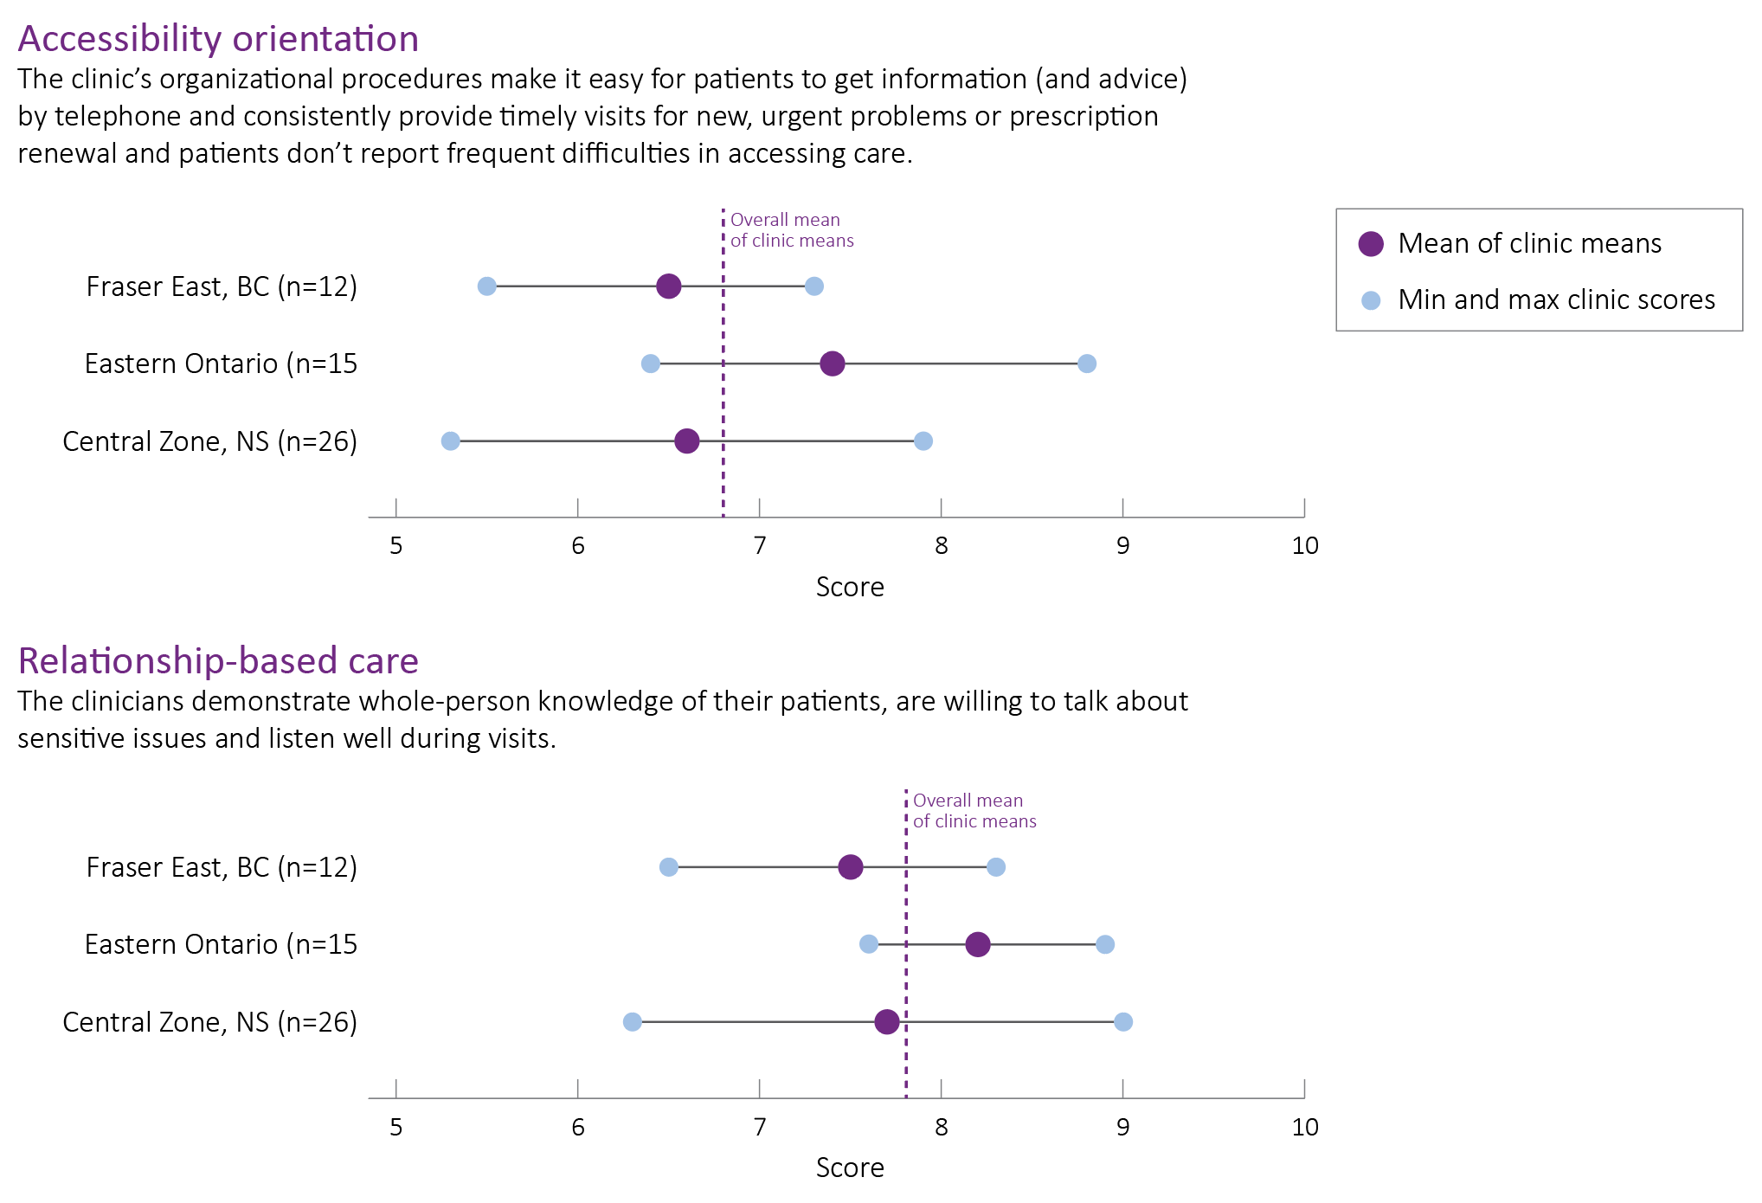
A closer look: Accessibility and relationship-based care

Slide 13
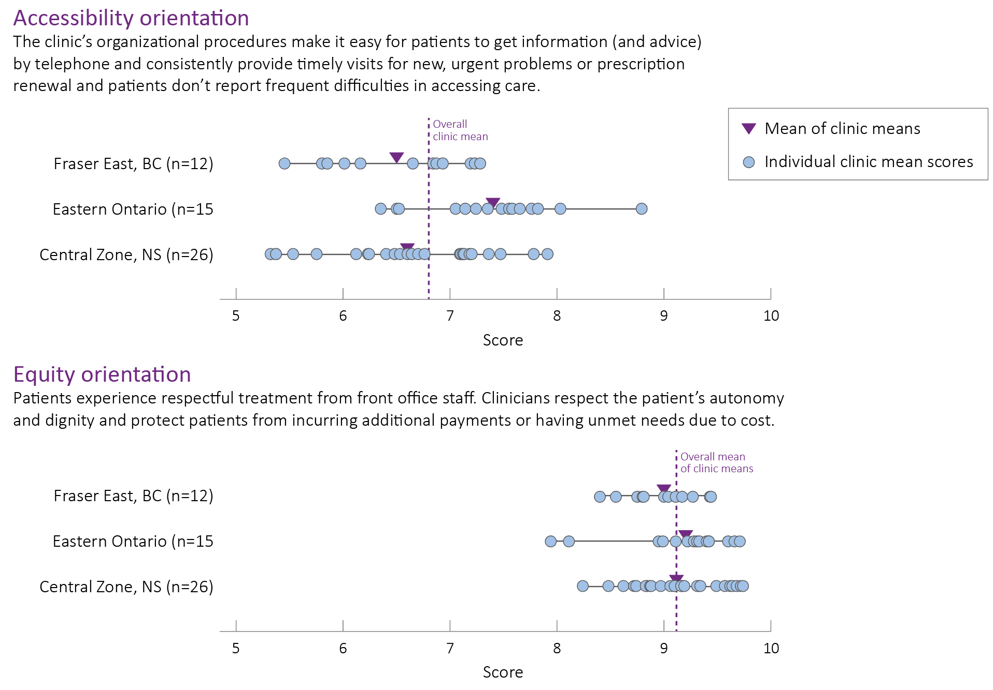
A closer look: Example showing all clinics
Notes:
Note: this is now real data

Slide 14
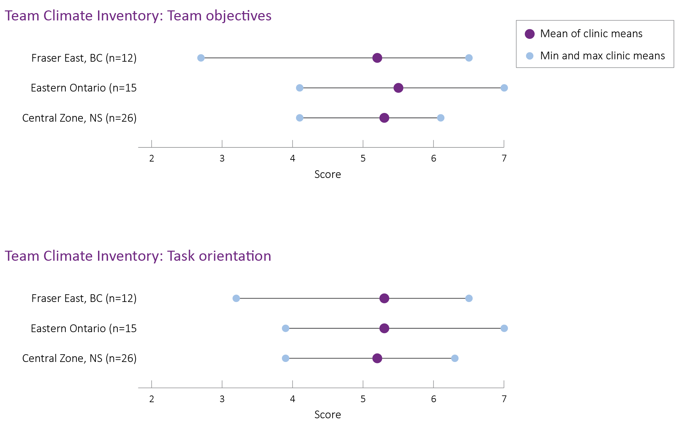
Team Climate Inventory:
Mean, min and max clinic scores, by scale

Slide 15
Findings Summary (preliminary)
Quantitative findings:
Patient reported experience/outcome:
Seven primary care dimensions clarified and reported
Regional variation detected
Early imagining of practice level variation
Health Administrative Data
Record linkage and data acquisition only just achieved

Slide 16
Findings Summary (preliminary)
Qualitative findings:
Case study data:
The extent of implementation varied by region:
Interprofessional team-based care
Clinician pool expansion
Physician groups and networks
Information systems
Remuneration
Performance measurement and reporting infrastructure
Patient/Citizen dialogue:
Regional public performance reports can enable advocacy for better community and personal care by patients and citizens
Provider-level public performance reporting is less useful, as lack of choice in providers limits ability to act as “consumers” who compare and choose high performing primary care providers

Slide 17
Impact
Comprehensive stakeholder informed performance reporting is feasible
  Patient experience; Patient outcome; Technical & Organizational Effectiveness
Linked practice-based multi-source performance measurement costs
  Recommend electronic and automated data collection systems for cost-reduction
Next steps are to analyze associations between organizational structures and patient experience and outcomes
Comprehensive performance measurement also needs to include clinical data from EMRs (CPCSSN/MaRNet/EVAN)
Context is important
Reporting on performance at the most meaningful aggregation level allows for actionable information by the right entity:
  Need to get to appropriate level: province, zone, network, cluster

