Slide 1
Patient-Reported Dimensions of Primary Care Performance TRANSFORMATION Study Results for the Central Zone
Presented by Fred Burge and Stephanie Blackman
Co-authors: Sabrina Wong, Sharon Johnston, Jeannie Haggerty
May 8, 2018
Halifax, NS
MEASURING AND IMPROVING THE PERFORMANCE OF PRIMARY HEALTH CARE IN CANADA

Slide 3
Developing Patient-Reported Dimensions of Primary Care
Design: Cross-sectional practice-based waiting room survey of patient experience
Study regions: Fraser East, BC; Eastern ON Health Unit, ON; Central Zone, NS
Participants: a minimum of 20 patients in each participating practice
Total: n=87 practices, n=1929 patient experience surveys
Central Zone: n=39 practices, n=878 patient experience surveys
Patient survey: 116 questions – validated subscales and items

Slide 4
Constructed patient-reported dimensions of primary care performance
Iterative, theory-driven process
Simplify reporting of a large patient survey dataset
Used a factor analytic framework (items and scales)
Developed composite measure for ease of reporting

Slide 5
Relevance of the Patient-Reported Dimensions to the ‘Health Home’ Model
Promoting health
Self-management support
Patient-Centered Care Relationship-based care
Continuity and coordination Coordination orientation
CQI and Safety Safe healthcare system
Equity orientation
Timely Access Accessibility orientation

Slide 6
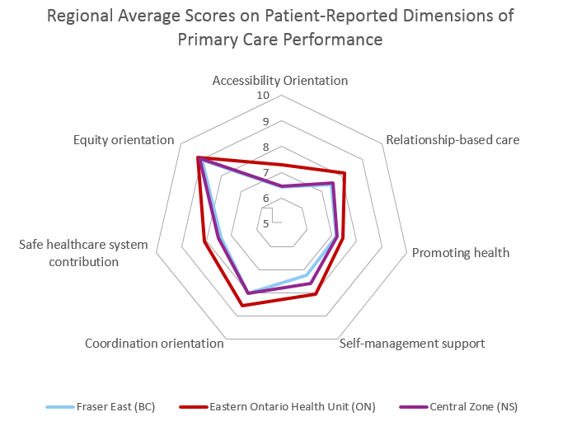
Notes:
Ontario practices scored highest across all 7 patient reported dimensions of primary care; BC and NS have most room for improvement

Slide 8
Relationship-based care
The clinicians demonstrate whole-person knowledge of their patients, are willing to talk about sensitive issues, and listen well during visits.
Promoting health
Patients receive health advice and health promotion appropriate to the context in their lives, and the staff actively encourages patients to attend groups or classes to help manage their health concerns.

Slide 9
Self-management support: For patients undergoing treatment. Clinicians engage in shared decision-making with patients receiving treatment and patients consistently report feeling better enabled to stick to treatment and care for their health.
Equity orientation: Patients experience respectful treatment from front office staff, and clinicians respect the patient’s time, autonomy, and dignity and protect low-income patients from incurring additional payments or having unmet needs due to cost.

Slide 10
Accessibility orientation:
The clinic’s organizational procedures make it easy for patients to get information (and advice) by telephone and consistently provide timely visits (< 3 days) for new or urgent problems or prescription renewal, and patients don’t report frequent difficulties in accessing care.

Slide 11
Coordination orientation
The clinicians have a robust role in initiating and following the care that patients receive from other providers and patients

Slide 12
Safe healthcare system contribution
For patients who receive care from other providers. Clinicians inform patients about risks associated with prescribed medicines, and patients do not experience gaps in the flow of information between provider nor report medical errors.

Slide 13
Reflections
We created 7 patient-reported dimensions of primary care performance, using 42 survey questions
Synthesizing multiple measures of patient-reported experiences can convey high-level information about performance
These 7 dimensions can speak to some aspects of the “health home” (e.g. patient-centered care, timely access, continuity and coordination, CQI and safety)
Additional data (organizational and provider surveys, administrative data) are required to get a fuller picture of “health home” performance

