Slide 1
Primary Care Performance Measurement and Reporting
Preliminary findings for regional performance portrait
Fred Burge for: Sabrina Wong, Sharon Johnston, William Hogg, Ruth Martin-Misener, Jeannie Haggerty, Emily Marshall
Nova Scotia extended team: Rick Gibson, Tara Sampalli, Lynn Edwards
April 12, 2018 Grand Rounds
MEASURING AND IMPROVING THE PERFORMANCE OF PRIMARY HEALTH CARE IN CANADA

Slide 3
Local supportive and integrated organizations

Slide 4
Primary care performance measurement and reporting framework needed to advance this health sector
Significant investments in different approaches to improving primary care over the past 10-15 years
Need for comprehensive performance measurement and reporting on these investments for system learning and accountability
TRANSFORMATION Study
Aim: to advance the mechanisms for regional-level primary care performance measurement and reporting
Study regions: Fraser East, BC; Eastern Ontario Health Unit, ON; Central Zone, NS

Slide 5
TRANSFORMATION
Four interrelated studies:
Compare measures of CBPHC performance and healthcare equity between regions, including comparative performance for complex vulnerable patients;
Examine contextual factors that may explain regional variation;
Develop and evaluate an approach to national reporting of CBPHC performance based on priorities and optimal reporting formats;
Identify innovations of service delivery associated with better CBPHC performance and healthcare equity;

Slide 6
Our data sources
Data sources
Quantitative Data,
Performance as organized by the Patient’s Medical Home Model (aka ‘health home’ in NS)
Practice survey data from:
Patients
Clinicians
Organizational leads
Practice team members
Health administrative data,
Quality indicators of:
Technical quality of care
Continuity
Health service utilization
Primary Care Performance Portrait
Qualitative Data
Data on regional context from case studies
What primary care policies / innovations / strategies have been adopted in each of the three study regions?
Data on performance reporting from patient-citizen dialogues
What performance information should be publicly reported? Uses? Formats?

Slide 7
What does it mean to be a health home?
Person- and family- centred
Timely access
Every patient has a most responsible provider
Comprehensive scope of services carried out by teams or networks of providers
Continuity and coordination of relationships, & information
Ideal sites for training and research
Electronic medical records (EMR)
Commitment to continuous quality improvement and safety
Strongly supported by governance structures, practice management, the public, etc.
Health homes work in collaboration with other health homes to foster collaboration
Adapted from: A Vision for Canada: Family Practice - The Patient's Medical Home (College of Family Physicians of Canada, 2011)

Slide 8
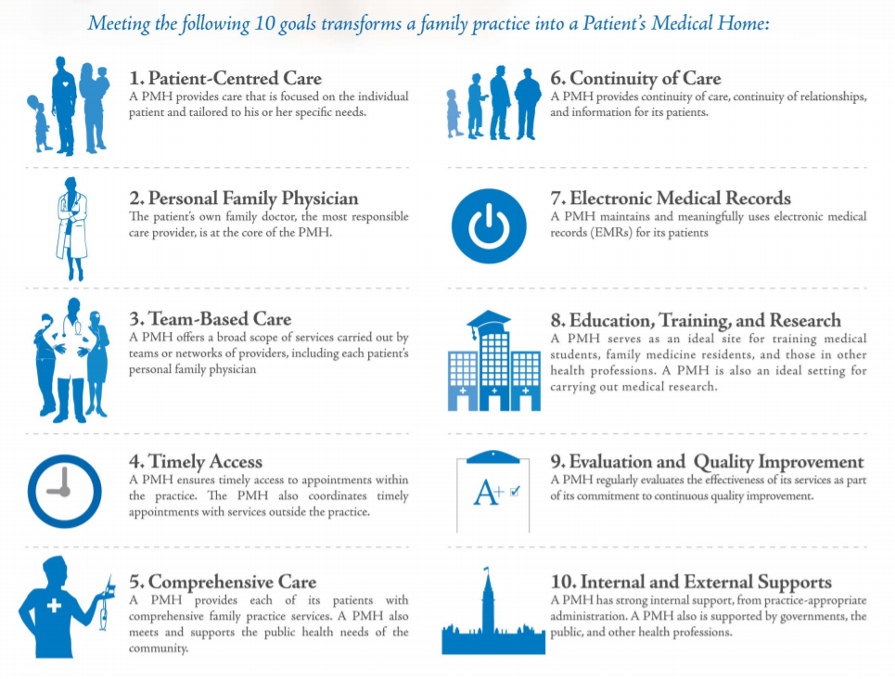
Portrait of Performance in Primary Care
The Patient’s Medical Home (PMH) is the CCFP’s vision for what the future of family practice in Canada will be. The information provided in this portrait shows results in three regions: Central Zone, NS; Fraser East, BC, and Easter ON Health Unit, ON. Cross-provincial regional reporting allows decision makers to reflect on strengths/weakness in primary care that may be shaped by different provincial/regional policies.
Create regional level performance portraits using data from quantitative (surveys, administrative data such as billing codes) and qualitative (document review, interviews, focus groups) sources
We link the information from these different sources to show how practices perform on some elements of the key pillars of the PMH: patient-centred care, team-based care, and electronic medical records.

Slide 9
Definitions of Dimensions
Relationship-based care: The clinicians demonstrate whole-person knowledge of their patients, are willing to talk about sensitive issues and listen well during visits.
Promoting health: Patients receive health advice and health promotion appropriate to their life context, and the staff actively encourages patients to attend groups or classes to help manage their health concerns.
Self-management support: For patients undergoing treatment. Clinicians engage in shared decision-making with patients receiving treatment and patients consistently report feeling better enabled to stick to treatment and care for their health.
Equity orientation: Patients experience respectful treatment from front office staff and clinicians respect the patient’s time, autonomy and dignity and protect low-income patients from incurring additional payments or having unmet needs due to cost
(n=504 patients at 22 clinics)
(n=547 patients at 26 clinics)
(n=878 patients at 39 clinics)

Slide 10
Contextual information: Innovations in interprofessional teams
ON has implemented the most extensive interprofessional teams of three study regions. BC and NS are moving towards more interprofessional teams, particularly in rural areas. This is being pushed by the adoption of the Patient’s Medical Home (BC) / health home (NS) models.
“So I have to go at one place, you know, my needs are taken care of right there. Everybody knows everything.” [ON patient]
“When we started looking around the province, there's collaborative practice teams all over the province, except in the densely populated areas. So we have a misaligned sort of distribution right now.” [NS key informant]
Examples of interprofessional teams in comprehensive primary care practices
British Columbia: Fraser East | Ontario: Eastern Ontario Health Unit | Nova Scotia: Central Zone
1 Community Health Centre (CHC) in Fraser East / 29 in the province | CHCs: 5-7 CHCs in EOHU / 74-87 in the province Family Health Teams (FHTs) were implemented in 2004. 2 in EOHU / 184 in province Nurse practitioner (NP)-led clinics were first implemented in 2007 1 in EOHU / 27 in province | CHCs: 2 in Central Zone / 25 in the province Community Health and Wellness Centres: 2 in Central Zone / 2 in province Collaborative Emergency Centres (CECs), were first implemented in 2011. 2 in Central Zone / 8 in province

Slide 11
PMH Pillar: Team-Based Care
Fraser East, BC
Eastern Ontario Health Unit, ON
Central Zone, NS
Health Professionals in PC Clinics (Mean Number)
(n=22 clinics)
(n=26 clinics)
(n=39 clinics)
Family physicians
Nurse practitioners
Registered nurses
Dieticians
Other
The ON region had more respondents who reported having other health professionals on their teams besides family physicians and also had a higher average number of these health professionals on their teams than the other regions.

Slide 12
PMH Pillar: Team-Based Care
Fraser East, BC
Eastern Ontario Health Unit, ON
Central Zone, NS
Health Professionals in PC Clinics (Mean FTEs)
(n=22 clinics)
(n=26 clinics)
(n=39 clinics)
Family physicians
Nurse practitioners
Registered nurses
Dieticians
Other
The ON region reported a higher average FTE for each of the types of health professionals working in primary care clinics.
Team Effectiveness (Mean Scores)
(n=20 clinics)
(n=21 clinics)
(n=22 clinics)
Participation in the team
Support for new ideas
Team objectives
Task orientation
Each of the three regions had similar scores for team effectiveness.
Notes:
Team Effectiveness: ‘Participation in the team’ & ‘Support for new ideas’ are scored out of 7; ‘Team objectives’ and ‘task orientation’ are scored out of 5

Slide 13
PMH Pillar: Team-Based Care (cont’d)
Fraser East, BC
Eastern Ontario Health Unit, ON
Central Zone, NS
Extent of ability to work with multiple providers outside clinic for care of complex patients
Very great extent
Some extent
Undecided
Not really
Not at all
When clinicians work with multiple providers outside of their clinic for complex patient care, clinicians across all regions reported being better able to have timely communication than effective collaboration.
More clinicians in the BC region reported having a ‘very great extent’ of ability to collaborate and communicate in a timely manner with other clinicians for complex patient care.

Slide 14
Contextual information: Innovations in information technology
Although EMR implementation is high across the three study regions, there is some variation in functionality within PC practices and across PC systems.
Data privacy issues impact the potential uses for such systems “…to the point where you can’t share information to get best outcomes.” [BC key informant]
Personal health records are still in an early stage of implementation across the three regions.
Telehealth and other health information technologies are also being used within the study regions to a limited extent
Examples of innovations in information technology within PC practices
British Columbia: Fraser East | Ontario: Eastern Ontario Health Unit | Nova Scotia: Central Zone
The Physician Information Technology Office (PITO) (2006) is responsible for facilitating general practitioners and specialists in the implementation of information technology (IT). | OntarioMD (ONMD) and eHealth Ontario support physicians moving from paper records to electronic medical records (EMRs) and electronic health records (EHRs) | The Frailty Portal supports physicians to assess and care for patients with frailty through a web-based tool The PHC Information Management and Electronic Medical Records (PHIM) project supports EMR implementation for the province.

Slide 15
PMH Pillar: Electronic Medical Record
Fraser East, BC
Eastern Ontario Health Unit, ON
Central Zone, NS
Information technology
Patients have the option to...
Request appointments or referrals online
Send a medical question/ concern via email
Request refills for prescriptions online
View test results on a secure website
(n=22 clinics)
(n=26 clinics)
(n=37 clinics)
Clinics in the ON region reported having less functionalities for patients to access IT services at their clinics.
Clinicians use electronic medical records in their clinics
(n=34 clinicians)
(n=35 clinicians)
(n=47 clinicians)
Whereas clinicians in the BC and ON regions (mostly) all used EMRs in their clinics, only 83% of clinicians used EMRs in the NS region.

Slide 16
Findings Summary (preliminary)
Quantitative findings:
Survey data:
Seven patient-reported primary care dimensions clarified and reported
Regional variation detected
Practice characteristics varied by region
Early imaginings of practice-level (practice portraits) and regional-level (regional portrait) variations
Health Administrative Data
Record linkage and data acquisition only just achieved

Slide 17
Findings Summary (preliminary)
Qualitative findings:
Case study data:
The extent of implementation varied by region:
Interprofessional team-based care
Clinician pool expansion
Physician groups and networks
Information systems
Remuneration
Performance measurement and reporting infrastructure
Patient/Citizen dialogue:
Regional public performance reports can enable advocacy for better community and personal care by patients and citizens
Provider-level public performance reporting is less useful, as lack of choice in providers limits ability to act as “consumers” who compare and choose high performing primary care providers

Slide 18
Impact
Comprehensive stakeholder informed performance reporting is feasible
Patient experience; Patient outcome; Technical & Organizational Effectiveness
Linked practice-based multi-source performance measurement costs
Recommend electronic and automated data collection systems for cost-reduction
Next steps are to analyze associations between organizational structures and patient experience and outcomes
Comprehensive performance measurement also needs to include clinical data from EMRs (CPCSSN/MaRNet/EVAN)
Context is important
Reporting on performance at the most meaningful aggregation level allows for actionable information by the right entity:
Need to get to appropriate level: province, zone, network, cluster

