Slide 1
Improving the performance reporting of primary care patient experience
Wong, S. T., Burge, F., Hogg, W., Johnston, S., Bouharaoui, F., Haggerty, J.
November 2017
NAPCRG, Montreal,QC
MEASURING AND IMPROVING THE PERFORMANCE OF PRIMARY HEALTH CARE IN CANADA

Slide 3
TRANSFORMATION Study
Objectives
Develop infrastructure for comprehensive reporting of PHC regional performance
Obtain insights from patients, clinician and decision-makers on PHC performance measurement and reporting
Study regions
Fraser East, BC; Eastern ON Health Unit, ON; Central Zone, NS
Study components
Regional case studies (context)
Practice-based patient and provider/organizational surveys linked to administrative data
Day-long deliberative dialogues
Notes:
Canadian primary care performance measurement and reporting is still developing
Need for improved science and meaningfulness in performance measurement
Multiple ways to measure a variety of primary care dimensions
Patient experience a key component of comprehensive performance measurement

Slide 4
Reporting Framework: Portrait of Patients’ Medical Home
Create regional level performance portraits using case study, survey, administrative data
Patient data

Slide 5
Developing Patient-Reported Dimensions of Primary Care
Design: Cross-sectional practice-based waiting room survey of patient experience
Participants: a minimum of 20 patients in each participating practice (n=87 practices, n=1929 patient experience surveys)
Patient survey: 116 questions – validated subscales and items

Slide 6
Objective: Construct patient reported dimensions of primary care performance
Iterative, theory-driven process
Simplify reporting of a large patient survey dataset
Used a factor analytic framework (items and scales)
Developed composite measure for ease of reporting

Slide 7
Accessibility Orientation Scoring: Technical Stuff
1. Telephone accessibility. The measure is anchored in a single question on the patient report of how easy it is get health advice over the phone? when needed.
2. Timeliness. Based on the premise that accessibility is most important for patients who have time-sensitive reasons for a visit, the following points are applied if patient indicated a time-sensitive reason for their visit that day (new problem, urgent, prescription renewal);
+1 if appointment in 1-to-2 days, including walk-in appointments
0 if patient waited between 3 to 7 days (or if reason-for-visit not time-sensitive)
-1 if the patient waited longer than 1 weeks
2 if the patient waited longer than 2 weeks.
3. Access difficulty. If the patient reported having difficulty accessing care at the clinic over the previous 12 months, the following points are further applied:
0 no difficulty reported
-1 for ‘yes, once’
-2 for ‘several times’
If the patient did not have a time-sensitive reason for the visit or did not report any difficulties, their score reflects only the reported ease of getting health
advice over the phone.

Slide 8
Performance dimension example: Accessibility orientation
Definition: The clinic’s organizational procedures make it easy for patients to get timely visits for health problems, and to get information (including advice) by telephone; patients don’t report frequent difficulties in accessing primary care.
Performance reflects the expectation that primary care clinics are principally responsible for first contact care in the health system; they should be organized to accommodate the abilities of a wide range of patients to seek and obtain care appropriate to the urgency of perceived health need.
The clinic score is the average of the individual scores of its patients. The individual patient score in this dimension is composed of 3 indicators (above). The final score is transformed to a 1-to-10 scale.
Notes:
Scoring
1. Telephone accessibility. The measure is anchored in a single question on the patient report of how easy it is get health advice over the phone? when needed.
2. Timeliness. Based on the premise that accessibility is most important for patients who have time-sensitive reasons for a visit, the following points are applied if patient indicated a time-sensitive reason for their visit that day (new problem, urgent, prescription renewal);
o +1 if appointment in 1-to-2 days, including walk-in appointments
o 0 if patient waited between 3 to 7 days (or if reason-for-visit not time-sensitive)
o -1 if the patient waited longer than 1 weeks
o 2 if the patient waited longer than 2 weeks.
3. Access difficulty. If the patient reported having difficulty accessing care at the clinic over the previous 12 months, the following points are further applied:
o 0 no difficulty reported
o -1 for ‘yes, once’
o -2 for ‘several times’
NB: If the patient did not have a time-sensitive reason for the visit or did not report any difficulties, their score reflects only the reported ease of getting health advice over the phone.

Slide 9
Results: Seven Patient-Reported Dimensions of Primary Care
PMH: Timely Access Accessibility orientation
Promoting Health
Self-management support
PMH: Patient Centered Relationship-based care
PMH: Continuity Coordination orientation
Patient reported impact: Safe healthcare system
Equity orientation
Notes:
Individual patient dimension scores averaged to the practice level, where actionability for improved performance is expected to happen

Slide 10
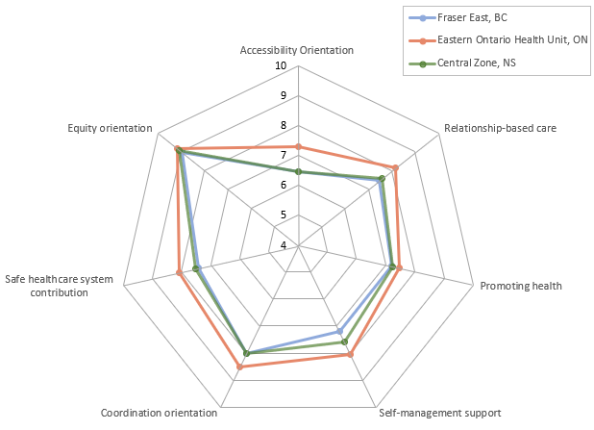
Mean clinic scores for each region
Ontario practices scored highest across all 7 patient reported dimensions of primary care; BC and NS have most room for improvement

Slide 11
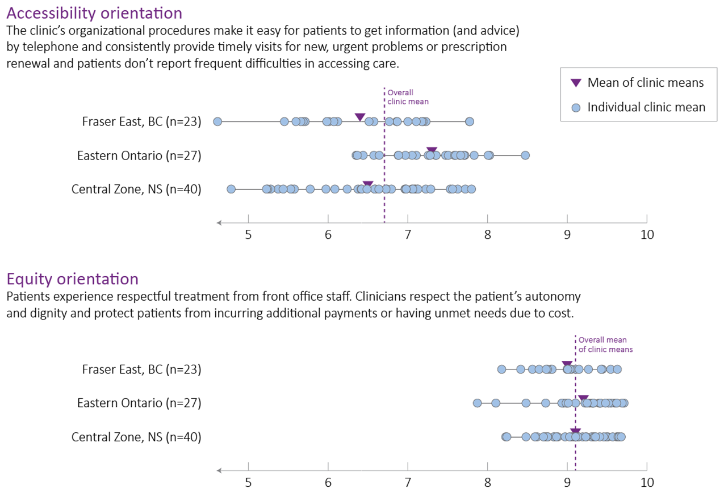
A closer look: Accessibility, Equity Orientation
Though limited patient sampling per practice detects significant between-practice difference, more patients per practice would increase reliability for individual practice feedback

Slide 12
Conclusions
Synthesizing multiple measures of patient or practice-reported experiences provides can convey high level information about performance
Information from single items or scales provide greater detail on where action may be needed
Policy interventions and support aimed at practice-level, rather than individual clinicians, could lead to more impact on strengthening patient experience
Next steps: examining what practice characteristics are related to improved patient reported experiences; whether patient experiences are related to outcomes
Notes:
Limitations: practice based surveys are expensive, only 3 areas in Canada, infrastructure to support ongoing work is needed

