Slide 1
Citizen, consumer, and patient roles in using publicly reported primary healthcare performance information
Lessons from citizen-patient dialogues in three Canadian provinces
Johnston, S., Abelson, J., Langton, J., Wong, S. T.
November 18th, 2017
North American Primary Care Research Group Annual Conference
Montreal, QC
MEASURING AND IMPROVING THE PERFORMANCE OF PRIMARY HEALTH CARE IN CANADA

Slide 2
Challenge
We don’t know how the public uses primary healthcare performance information in Canada.

Slide 3
Objective
Learn how the public uses and values primary healthcare performance data, to inform effective public reporting systems.

Slide 4
3 roles in health system public engagement
Citizen / resident Consumer Patient
Notes:
To understand how to optimally public report, especially given the may different purposes of performance reporting, we wanted to understand how people might use different performance informaiton- and what purpose for erporting this activity might serrve. Mutliple roles described in the literature for public engageemtn in health care and specifically public perforamcne reproting.
There are three well described roles for members of the public engaging in health care decision-making whether policy and priority decisions or health management and seeking care decisions. The role of citizen or resident described by Loma, etc is
In contrast the role of a consumer asdexcribed by Hibbard and xx reflects the coice of where or from whom to seek care while the role of patient usually refelcts decisin-making about one’s own care or in a cregiver role support and decisionmaking about a family or friends’ care.

Slide 5
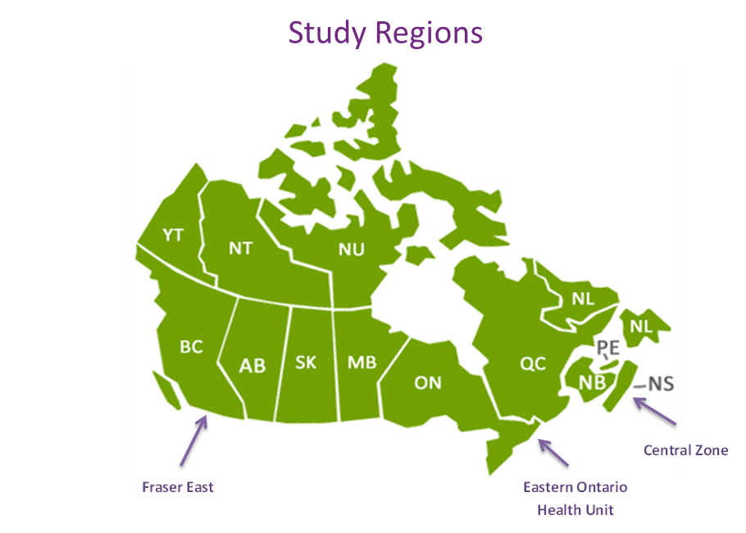
Methods
Design: Deliberative dialogues (DD) Public participation method for complex issues
2 full-day DD sessions per study region (6 in total; n=56 participants)
Recruitment: Subsample of practice-based survey participants; volunteer / employment opportunity online platforms
Data Collection and Analysis: Qualitative group discussion. Transcripts coded (by 2 team members) using inductively created coding template; Identified emerging themes and iteratively interpreted findings

Slide 6
Dialogue topics
What to report
Priorities for public reporting on common performance domains and their related indicators
How information is used
Explored views on how PM information could be used
Considered different roles as citizens, consumers, patients
How to report:
Perspectives on various PC performance reporting formats

Slide 7
Findings: PC information fuels citizen role
Most common role:
advocacy for better primary care in their community

Slide 8
Findings: PC information fuels citizen role
“And if you’ve got some districts performing better than other districts and the public knows that, that’s where the pressure comes from to change, and that’s the only way you’ll get change in the healthcare system is by public pressure, pressuring the government and then it works its way down. And that’s the only way to do it.”

Slide 9
Findings: PC information fuels citizen role
Taking action to improve services
“[performance] information, …. gives that community a sense to become more involved, more involved in helping to open a smaller clinic or helping other people in transportation ...”

Slide 10
Findings: PC information fuels citizen role
Accountability
“You’re paying tax dollars, you want to know where those are going and what it’s being used for.”

Slide 11
Findings: PC information fuels citizen role
Mixed views on usefulness of national or regional comparisons
“I think it’s important … both as a taxpayer and someone that wants to be informed about healthcare practices … you have to know what’s going on in your own backyard, but you also have to know what’s going on in the rest of the country, as well.”

Slide 12
Findings: limited role for PC information in consumer role
Barrier: lack of choice in providers
“But the problem with that is that you rate a doctor, you don’t like the rating, you have nowhere else to go.”

Slide 13
Findings: limited role for PC information in consumer role
Personal experience and relationship with provider valuable
“Well, if they got a crappy rating, I might consider doing something about it, [if]…the doctor didn’t spend enough time with the patient, that might be an issue that was personal to me, and it might be enough to cause me to go somewhere else, but, I don’t know. Most people who do have a GP or are connected with their GP already to some extent, it’s challenging for them to go to another GP if they did get a bad rating.”

Slide 14
Findings: limited role for PC information in consumer role
Performance information useful for those those seeking a new provider; e.g. moving
Unintended effects: promote doctor-shopping and system imbalance
“What kind of frightens me is if you get it from practice to practice or doctor to doctor the thing is people say, “Well, I’m not going to go see that doctor anymore. I’m going to go try that one over here.” So doesn’t that put an overload on another area, and less of a load here”

Slide 15
Findings: How PC information is used in patient role
To better engage patients in their care
Public knowledge on best practices
Capacity to advocate for better care
“…if I saw that they had low screening rates, if it was publicly provided information, then I could be, like, “Oh, I didn’t know I was supposed to have that screening. Now I know that I should ask.” But if that information’s not provided, then I don’t know that that’s something I’m supposed to be screened for.”

Slide 16
Findings: How PC information is used in patient role
To enable trust in the provider
“Being a patient, I don’t know how good the physician is up-to-date …Does he follow with new procedures and everything else? …I want to make sure I get access to a physician that’s right up there, …I would appreciate knowing about it, if it can be measured and it would push the ones that are just sitting there just doing their jobs and not opening their minds to new stuff—…I think it gives me more assurance that I’m seeing the proper person or doctor .”

Slide 17
Discussion
Public reporting was consistently viewed as empowering, especially in the citizen role.
Limited choice impacted perceived capacity to act on information as a consumer.
Performance information can strengthen patients’ engagement in their care and trust in provider and system.

Slide 18
Conclusion
Tailor our reporting to enable different roles which drive purpose of public reporting
Address barriers to uses of public performance information

