Slide 1
Meaningful measurement
TRANSFORMing primary care by improving the science and reporting of performance
Sabrina T Wong; Rebecca S. Etz; Fred Burge; Robert L. Phillips Jr; Meredith Kraztman; William Hogg; Richard H. Glazier
NAPCRG, November 2016
MEASURING AND IMPROVING THE PERFORMANCE OF PRIMARY HEALTH CARE

Slide 2
Objectives for today’s session
Identify strategies in Canada and the US to measure and report quality performance of community-based primary health care (CBPHC)
Identify mechanisms to compare Canadian and US PHC measures
Enable real-world problem-solving through a bi-national, multi-stakeholder learning community

Slide 3
Agenda:
Introduction
Defining common terms
Examples:
  Canadian initiatives: CBPHC Common Indicator Project; TRANSFORMATION Study
  American initiatives: Primary Care Measures That Matter; PRIME primary care registry project
Group discussion
Next Steps

Slide 4
Definition of common terms
Measures vs metrics
  Value at a given point vs a point compared within a context
Meaningful measures
  Use, validity, reporting function, motivation, context
Object of measure
  Primary care, specialty, experience of care, health
Purpose of measurement
  Informs what makes it meaningful
Notes:
Why measure performance?
Influx of recent reforms and investments made in CBPHC
Need to monitor impact and effectiveness
The “black box” of primary care (CIHI 2009)

Slide 5

Community-Based Primary Health Care Common Indicator Project
12 CBPHC Innovation Teams
Sabrina Wong, Jeannie Haggerty, Rick Audus, Eva Grunfeld, Stewart Harris, Janusz Kaczorowski, Alan Katz, Clare Liddy, Jenny Ploeg, Moira Stewart, Walter Wodchis, Kue Young
Funded by:
TRANSFORMING PRIMARY CARE BY IMPROVING THE SCIENCE AND REPORTING OF PERFORMANCE

Slide 6
CBPHC Common Indicators Project
12 CBPHC Innovation Teams funded by CIHR
  Cross-jurisdictional
  Focus
    Access to CBPHC for vulnerable populations
    Chronic disease prevention and management
Common indicators are being measured across the 12 teams
Innovative approach to comparative research

Slide 7
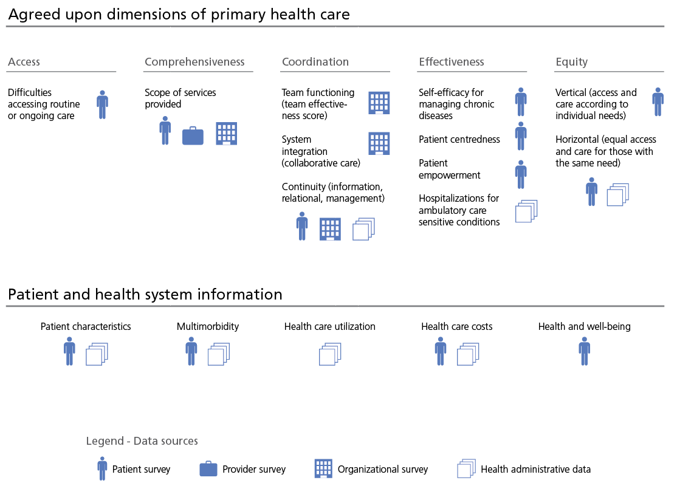
Agreed upon PHC dimensions
Patient and health system information
Notes:
Attention to group process and utilizing all expertise (funders, researchers, community partners) resulted in a mutually acceptable set of measures and common approach to data collection. Despite heterogeneity in terms of study designs within and across each of the 12 teams, the working group was able to identify a set of common dimensions, indicators, and measures. Across the 12 teams, we are collecting data on core dimensions of primary care including: accessibility, comprehensiveness, coordination, effectiveness of care, and health equity (Figure 1). There are a number of items covering these five domains and additional information on patient characteristics, multi-morbidity, health and wellbeing, and health care utilization and costs. Much of this work also measures some of the CIHI pan-Canadian indicators

Slide 8
CBPHC Common Indicators Project: Strategies for measurement
Work to date
  Review of existing primary health care indicators and protocols for 12 teams
  Consensus process on important dimensions
  Data collection underway
Next steps:
  Narrative synthesis, realist review
  Quantitative analyses: psychometrics, trends

Slide 9



The TRANSFORMATION Study
Measuring and improving the performance of primary health care in Canada
Sabrina Wong, William Hogg, Fred Burge
University of British Columbia, Bruyère Research Institute, Dalhousie University
Funded by:
TRANSFORMING PRIMARY CARE BY IMPROVING THE SCIENCE AND REPORTING OF PERFORMANCE

Slide 10
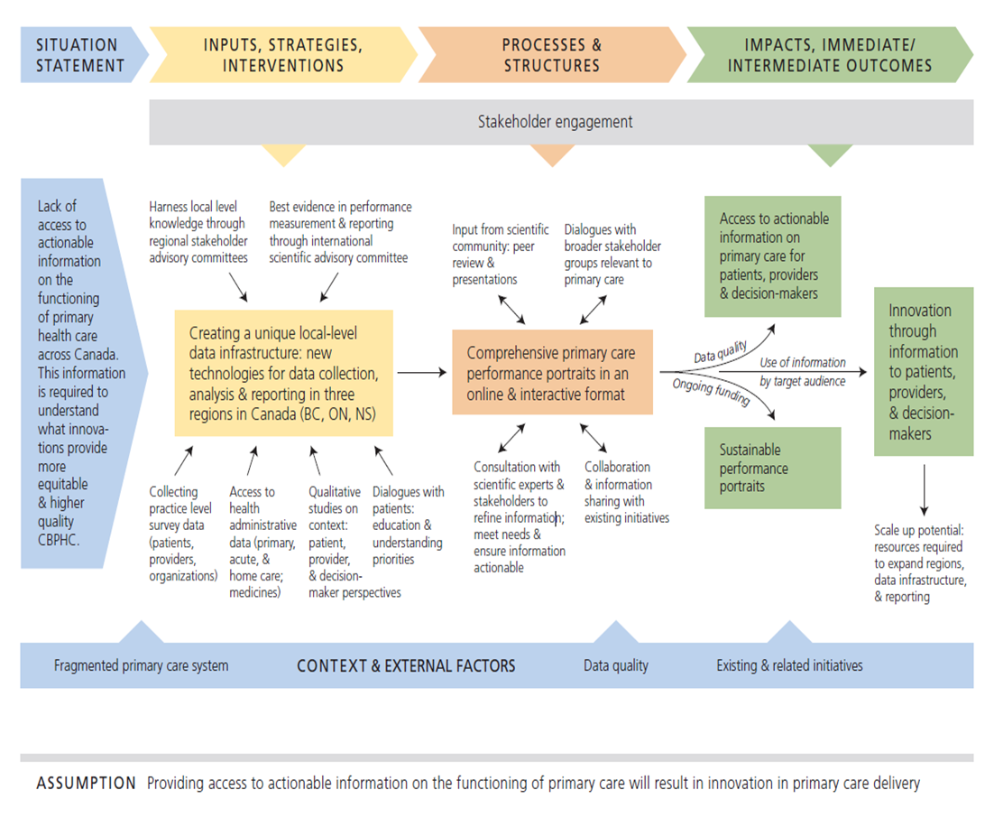
TRANSFORMATION Study: Processes, Outputs and Impacts
Datasets from individual study components
Integrated dataset for comprehensive comparisons of performance across study regions
Comprehensive performance portrait

Slide 11
TRANSFORMATION Study: Performance Measurement
Meaningful measures-regional and practice based
  Accessibility (e.g. timeliness, unmet needs, acceptability, financial accessibility)
  Appropriateness (e.g. patient-centred communication, respectfulness, coordination, technical quality, continuity, comprehensiveness of services delivered, health promotion)
  Effectiveness (e.g. safety, functional status, team functioning, trust/confidence)
  Productivity (e.g. healthcare utilization)
  Impact (e.g. patient-reported impacts of care, functional status, health)
  Efficiency
  Equity

Slide 12
TRANSFORMATION Study: Performance Reporting
Purpose of reporting: Access to actionable information in primary care for patients, providers and decision-makers
Meaningful reporting
  Comprehensive regional performance portraits
  Practice-based portraits (BC & NS only)
Notes:
Considerations on reporting
Audience: How to report info to your primary target audience while making info useful for other audiences in order to facilitate engagement
Formatting: Implications on cost, reach and sustainability

Slide 13
TRANSFORMATION Study: Strategies for measurement and reporting
Measurement
  Practice-based surveys: patient, provider and organizational
  Health administrative data
  Case studies (document review, key stakeholder interviews, clinician and patient focus groups) to capture innovations in primary care
  Missing: extractions from electronic medical records (due to cost)
Reporting
  Deliberative dialogues (2 in each study region) to capture patient priorities on performance measurement
  Case studies (key stakeholder interviews, clinician and patient focus groups) to obtain feedback on draft portrait

Slide 14



Primary Care Measures That Matter
Rebecca Etz, Marshall Brooks, Martha Gonzalez, Sarah Reves
VCU School of Medicine, Department of Family Medicine and Population Health
Funded by:

Slide 15
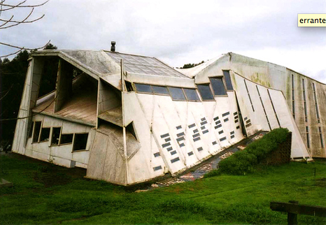

Primary care measures that matter
It began with a study of exemplars
  Funded by RWJF, exemplars of workforce innovation
  4400 abstracts, 350 papers, 1200 leaders, 250 practices

Slide 16
Primary care measures that matter
Missing:
  Feedback on performance
  Direction for innovation
  Reflection to transform
Are my patients doing better?
Is it a good experience for them?

Slide 17
Primary care measures that matter
It continued with listening to stakeholders
  What matters for “good care” and “quality”?
  Crowd-sourcing surveys:
    Clinicians – 525
    Patients – 412
    Employers – 85
  Coding for existing models, overlaps, and emergence
    Existing models for clinicians, 92 codes
    Emergent for clinicians, 18 codes
    These 18 served as the model for patients and employers

Slide 18

Primary care measures that matter
What we learned
from clinicians
Tunnel vision?
Myopic focus?
Wishful thinking?
5000 responses
92 codes applied
3 coders with 85% agreement
38%

Slide 19

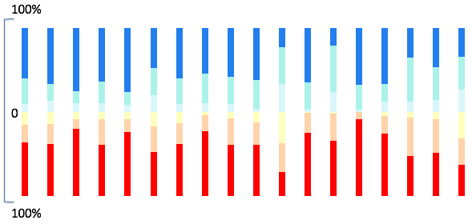
Primary care measures that matter
What we learned
from clinicians
18 clear areas of alignment
Learning Organization Care Coordination
Resource Stewardship Data Capacity
Teamness Comprehensiveness
Population Health Professionalism
Personalized Care Physician Self Care
Scope of Work Approachable
Patient Self Care Respect of Persons
Being Known Meaningful Access
Goal Oriented Care Patient Assessment of Practice

Slide 20
Primary care measures that matter
Just beginning to analyze all three
  For clinicians: it’s about alignment
  For patients: it’s about favoring what’s possible over providing for potential
  For employers: it’s about pragmatics
What’s next
  DREAM QI – how are measures and QI related
  PC METRIQs – what happens when it’s meaningful
  PROMIS for PC – learning to listen

Slide 21
PRIME
Bob Philips
“Primary care is PRIME: honoring the past, navigating the future”

Slide 22
Value-based payments
Continuous Certification
PRIME Registry
Researchers
Measure Development
Social Determinants & Community Engagement
Notes:
PRIME—what it is, who’s eligible, other sister registries
Once physicians join the registry, the ABFM is looking at ways to even further add value for them—by incorporating social determinant data to get a broader view of the community in which they practice. We want to reduce the burden on you to collect the data, and then also make them more useful

Slide 23
Quality Payment Programs: How will you be measured?

Slide 24



$112M to help 1,750 small practices improve
$800M to help 140,000 clinicians improve quality of care, increase patients’ access to information, and reduce costs
Access and Continuity
Comprehensiveness and Coordination
Planned Care for Chronic Conditions and Preventive Care
Risk-Stratified Care Management
Patients and Caregiver Engagement
Coordination of Care Across the Medical Neighborhood
Notes:
Internet Citation: EvidenceNOW: Advancing Heart Health in Primary Care. October 2015. Agency for Healthcare Research and Quality, Rockville, MD. http://www.ahrq.gov/professionals/systems/primary-care/evidencenow.html
EvidenceNOW comes out of the Patient Centered Outcome Research trust fund, TCPI out of ACA trust fund
CPC is a payment model = FFS + CMF + Shared Savings

Slide 25
Comprehensive Primary Care +
Practices in both tracks will make changes in the way they deliver care, centered on key Comprehensive Primary Care Functions:
(1) Access and Continuity
(2) Care Management
(3) Comprehensiveness and Coordination
(4) Patient and Caregiver Engagement
(5) Planned Care and Population Health

Slide 26
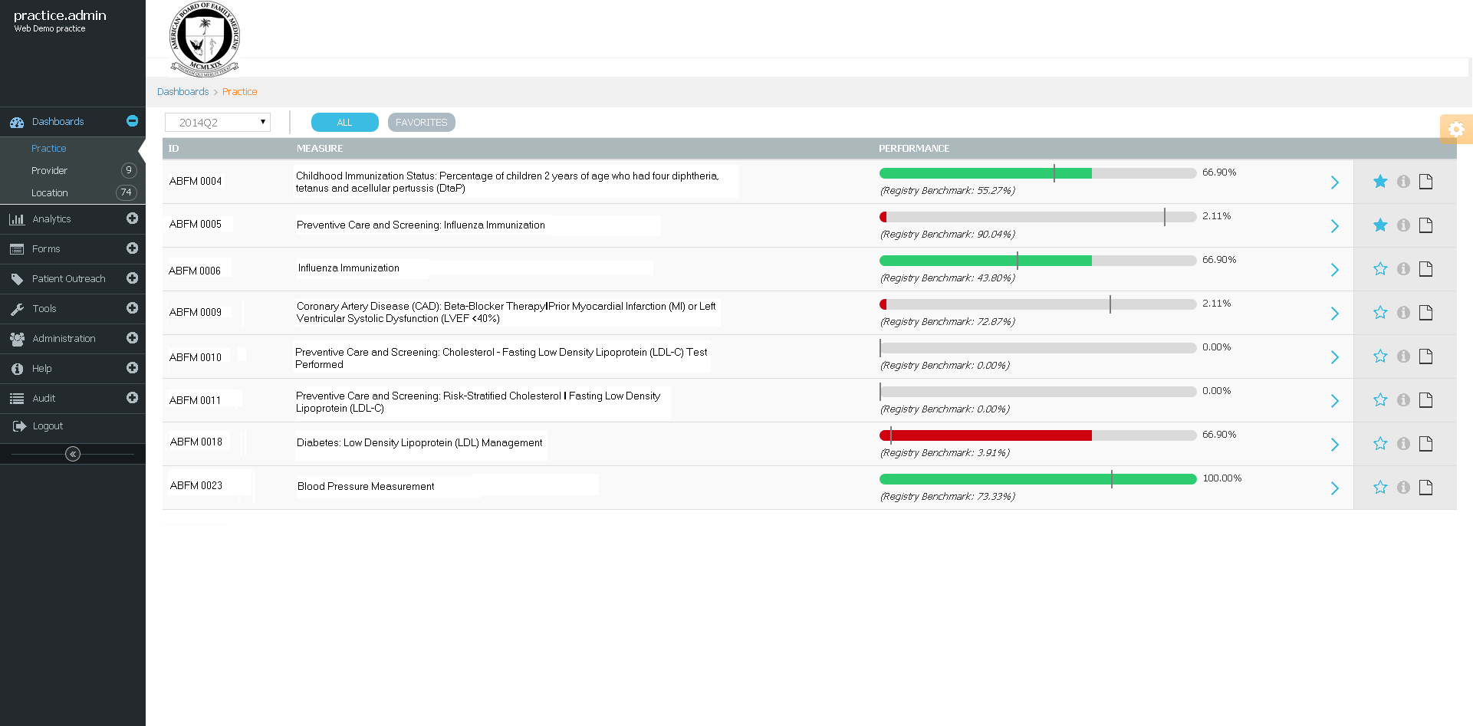
PRIME Dashboard
41 measures to start, 3 more added for EvidenceNOW!
May add Continuity measure(s) next
Notes:
Dashboard practice
Talk about FIGMD here??
You will receive a dashboard for every patient—so that you have something to take action on—and an aggregate dashboard like this one. This is also similar to what would appear in your MOC portfolio. The thresholds will not be used against you, but rather help you identify either where you have data gaps or quality gaps.
We anticipate a lot of data gaps early on. Measures are dependent on how data are captured and where they are stored, so early on, measures are most likely to be affected by how you or your staff do this, and whether you are consistent. It I s painful, we understand, but if it looks bad here, it may look bad to payers too.

Slide 27
PRIME Registry measures
Working with Robert Graham Center on new measures for:
  Continuity
  Comprehensiveness
  Interaction of Continuity & Comprehensiveness
  Care Coordination
Moving Performance Improvement Activity into Registry to make them “measures”
10 Building Blocks of Primary Care

Slide 28
SMALL GROUP DISCUSSION
Meaningful measurement
  How do you define meaningful measures?
  What are we measuring and from who’s perspective? (purpose of measurement)
Meaningful reporting and recommendations for priority areas
  What is the purpose of reporting measures and priority areas in which the most important commonalities should be present?
Feasible strategies for measurement and reporting
  What strategies do you suggest for measuring and reporting the performance of primary care?

Slide 29
SUMMARY OF SMALL GROUP DISCUSSION
Rick Glazier

Slide 30
Next Steps (Meredith Kratzman, CIHR)
Interest for a research cooperative to facilitate (national, binational, international) focus on measures that are
  Meaningful
  Parsimonious
  Able to scale up and down

