Slide 1
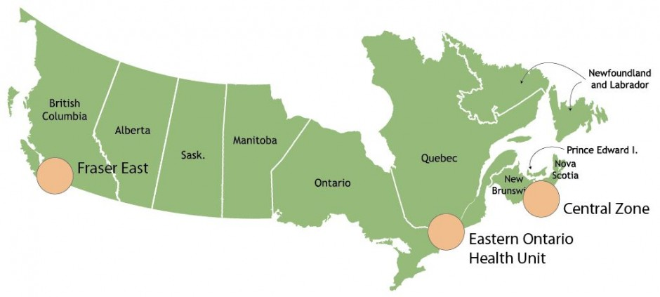
Comparative case study of strategies to improve primary health care (PHC) human resources in three Canadian provinces
Martin-Misener, R., Wong, S., Johnston, S., Burge, F., Scott, C., Blackman, S., Parks, C., French, I
Contact: ruth.martin-misener@dal.ca
Background
In 2004 Canada’s premiers and first ministers agreed to make PHC reform a policy imperative. Over the past decade many policies supporting innovations in PHC organization and service delivery have been introduced to improve previous reports of poor performance^{1,2} with investments totaling over $1billion.³ In 2012, the Canadian Working Group for PHC Improvement recommended that performance measurement be a strategic priority in PHC research.³ The TRANSFORMATION Study seeks to address the need for a better understanding of Canadian PHC performance measurement and reporting.
Methods
Objective: Describe the strategies enacted to improve PHC in 3 provinces, comparing spread and uptake.
Design: A case study design with three cases, comparable health regions in Canada⁴ (Fig 1) and embedded units⁵ of innovations in PHC service delivery and organization in each case.
Data sources for each case: (Tbl 1) Purposively selected
Key informant interviews
Patient and provider focus groups
Published and unpublished documents describing/evaluating innovations implemented in PHC settings since 2004. Documents were obtained through PubMed, CINAHL, Dissertations and Theses and websites of government and health care organizations.
Analysis: Our analysis was sensitized by frameworks conceptualizing the context of PHC⁶ and public policy analysis⁷. We used NVivo (v.10) to code extracted data from documents (Fig 2) and interview and focus group transcripts.
Preliminary Results
Many included documents were descriptive and/or had no identified methodology (Fig 3). The province with the most quantitative observational and RCTs is ON (n=17), compared to NS (n=7) and BC (n=5). More mixed methods approaches were used in BC and NS (n=9 each) than in ON (n=2).
Three human resource strategies were identified: interdisciplinary team-based approach; expansion of the primary health care provider pool (new roles and optimization of existing roles); and physician group practices and networks (Tbl 2).
Conclusions
The provinces vary in where they have made investments in health human resource innovations in PHC. Spread of the innovations varies from province-wide to regional. Determination of comparative effectiveness is complex and complicated by differences in the amount and quality of research within each province. Completing our interview and focus group data analysis will further illuminate differences in implementation and spread of these innovations.
Citations
Blendon, R.J., Schoen, C., DesRoches, C., Osborn, R., & Zapert, K. (2003). Common concerns amid diverse systems: health care experiences in five countries. Health Affairs. 22 (3) 106-121.
Schoen, C., Osborn, R., Huynh, P., Doty, M., Zapert, K., Peugh, J., & Davis, K. (2005). Taking the pulse of health care systems: Experiences of patients with health problems in six countries. Health Affairs. 5:509-525.
Aggarwal, M., & Hutchison, B. (2012) Toward a Primary Care Strategy for Canada. Ottawa, Ontario: Canadian Working Group for Primary Healthcare Improvement.
Statistics Canada (2015). Health regions 2013 by peer group. Retrieved from www.statcan.gc.ca/pub/82-402-x/2013003/regions/hrt8-eng.htm
Yin, R.K. (2013). Case Study Research: Design and Methods. 5th ed. SAGE Publications.
Hogg, W., Rowan, M., Russell, G., Geneau, R., & Muldoon, L. (2008). Framework for primary care organizations: the importance of a structural domain. International Journal for Quality in Health Care. 20 (5):308-313.
Morestin, F. (2012). A Framework for Analyzing Public Policies: Practical Guide. National Collaborating Centre for Healthy Public Policy. Government of Quebec.
College of Nurses of Ontario (2016). Membership Statistics Report 2015.
Acknowledgements
This work is funded by:
Figure 1. Study regions
Figure 2. Data elements extracted from documents
Province | Goals of the policy/innovation
Location | Policy drivers
Scope of focus | Roots or foundational background of policy/innovation
What does this paper address? | Extent of policy/innovation implementation/spread
Type of paper | Evaluation of effectiveness, unintended effects, equity, acceptability, feasibility, costs
Purpose/hypothesis | Limitations to generalizability of study results
Methods | Performance measurement or reporting (planned or completed)
Stakeholder involvement
Figure 3. Document Sources by Methodology
Table 1. Number of data sources in each case
 | Documents | Key-Informant Interviews | Clinician Focus Group Participants | Patient Focus Group Participants
BC | 95 | 6 | 6 | 5
ON | 64 | 6 | 6* | 7
NS | 46 | 8 | 15 | 5
Table 2. PHC HR implementation/investment by province
*In Ontario, individual semi-structured interviews were conducted with PHC clinicians in lieu of a focus group.
 | BC | ON | NS
Inter-Professional Teams | Minimal implementation/ investment. Specific population focus e.g. at risk children; rural maternity care. | Considerable implementation/investment in teams within PHC practices. Provincially defined team structures with accountabilities e.g. family health teams (FHT); community health centres (CHC). Province wide since 2005 ~150 new FHTs. Are also ~50 CHCs some predating 2005. | Some implementation of community-based teams with health promotion focus external to PHC practices. Some implementation/investment in IP teams within PHC practices in province but minimally in case study region. Collaborative Emergency Centres are a new model with a PHC component.
Provider Pool Expansion: New Roles | Some implementation/ investment in NPs. NP legislation/regulation 2005 ~500 NPs province wide. Most in acute care or community-based settings serving specific population e.g. elder care, high risk mothers. Few in generalist PHC practices. | Considerable implementation/investment in NPs. NP legislation/regulation 1995. 2587 NPs province wide: 58% in community⁸ Many NPs within PHC generalist practices including NP-led Clinics, also other LTC and community-based settings serving specific populations e.g. palliative care. Recent new investments. | Some implementation/ investment in NPs. NP legislation/regulation 2002. ~150 NPs province wide. ~Half within PHC generalist or LTC practices and half in acute care. Recent new investments.
Provider Pool Expansion: Optimizing Existing Roles | Minimal use of existing roles in generalist PHC practices. RN role expanded in rural/remote areas. | Some integration of pharmacists, RNs, OT and other roles in PHC generalist practices. Pharmacist role expanded. | Some integration of RNs in PHC. generalist practices. Pharmacist and paramedic role expanded.
Physician Group Practices and Networks | Considerable implementation/investment at provincial (General Practice Service Committee) and regional level (12 divisions). Focus includes governance/policy, quality improvement, and service delivery. | Considerable implementation/investment at local practice level e.g. (Family Health Organization, Family Health Network). Focus is mainly service delivery. | Some implementation/investment at regional level (e.g. District Department of Family Practice). Focus is mainly governance/policy and quality improvement.
Key | Minimal Implementation/investment | Some implementation/investment | Considerable implementation/investment
MEASURING AND IMPROVING THE PERFORMANCE OF PRIMARY HEALTH CARE IN CANADA

