Slide 1
Developing population segments with
different primary health care needs An analysis using health administrative data in British Columbia, Canada
Kim McGrail, Julia M. Langton, Sandra Peterson, Alexandra Choi, Fred Burge, William Hogg, Sabrina T. Wong
November 2016
NAPCRG
MEASURING AND IMPROVING THE PERFORMANCE OF PRIMARY HEALTH CARE IN CANADA

Slide 2
Orientation
Improvement is always possible but is difficult to achieve in the absence of actionable information
Langton J, Wong ST, Johnston S, Abelson J, Ammi M, Burge F, Campbell J, Haggerty J, Hogg W, Wodchis W, McGrail KM. Healthcare Policy 12(2): 33-51. 2016.

Slide 3
Why population segments?
Scoping review of jurisdictional approaches to performance measurement, and associated literature
Workshop with multiple stakeholder groups for input and priorities
Multi-disciplinary team for review and comment
Strong support for reporting at sub-group level

Slide 5
Healthy
Primary care
Coordinated care
Frail / end of life

Slide 6
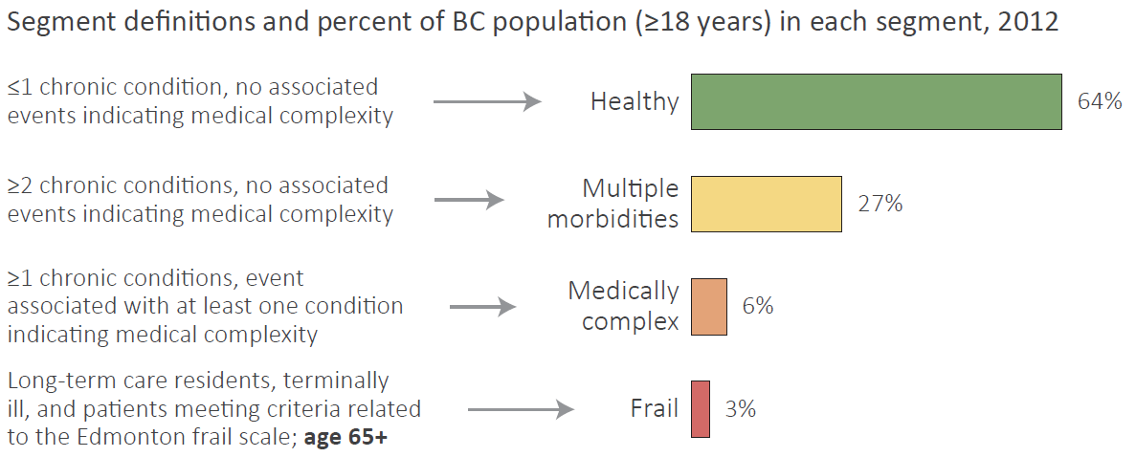
Population segments
Healthy
Multiple morbidities
(Primary care)
Medically complex
(Coordinated care)
Frail / end of life

Slide 7
Identifying medical complexity
…

Slide 9
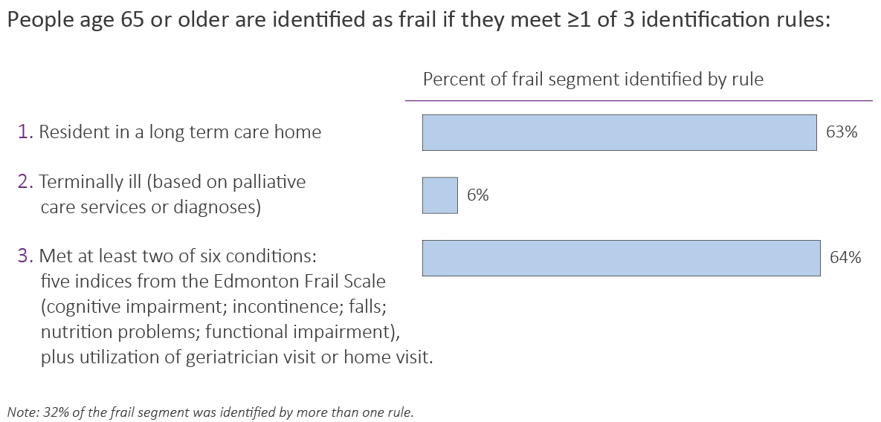
Identifying frailty

Slide 10
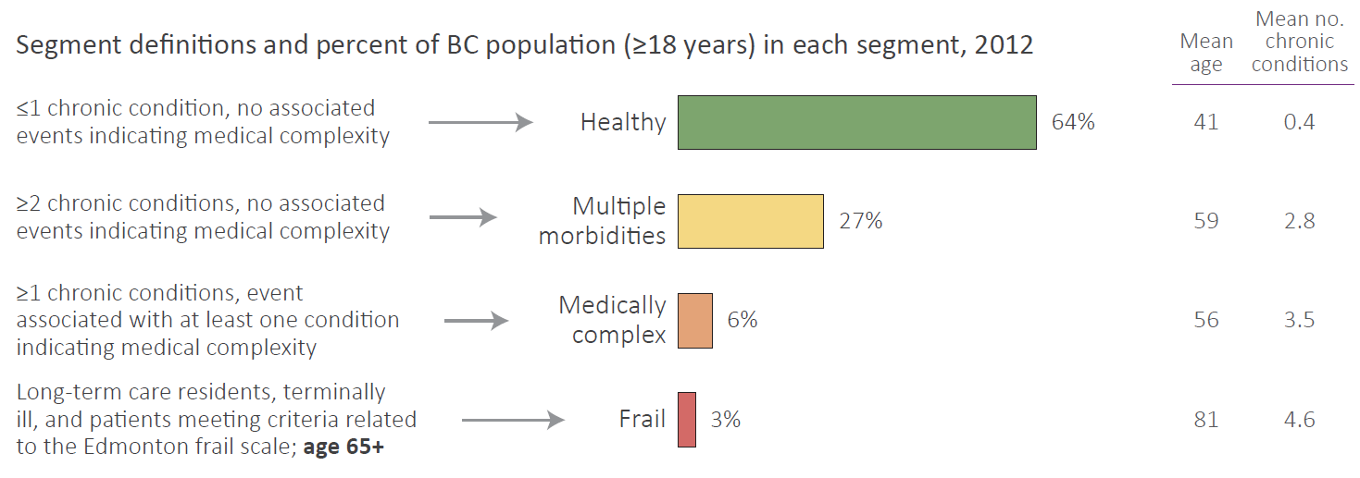
Population segments

Slide 11
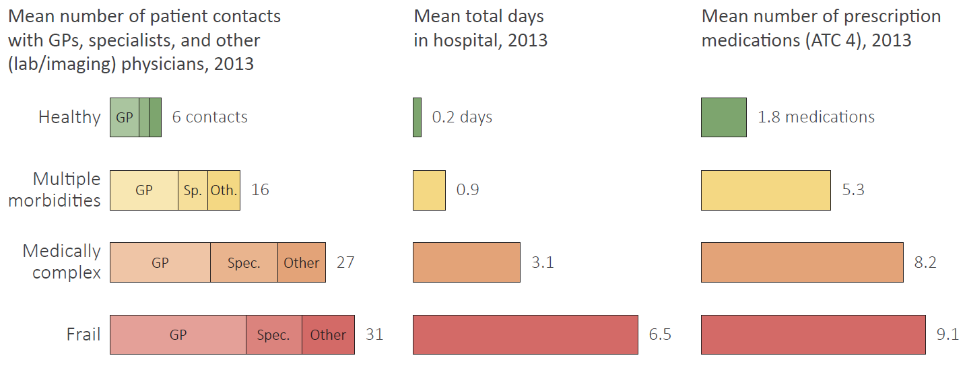
Physician, hospital, and medication use by pop. segment

Slide 12
Next Steps
Produce performance measures by segment
Provide information to research partners for review and feedback
Modify (if necessary), continue building measures, continue perfecting presentation of information

