Slide 1
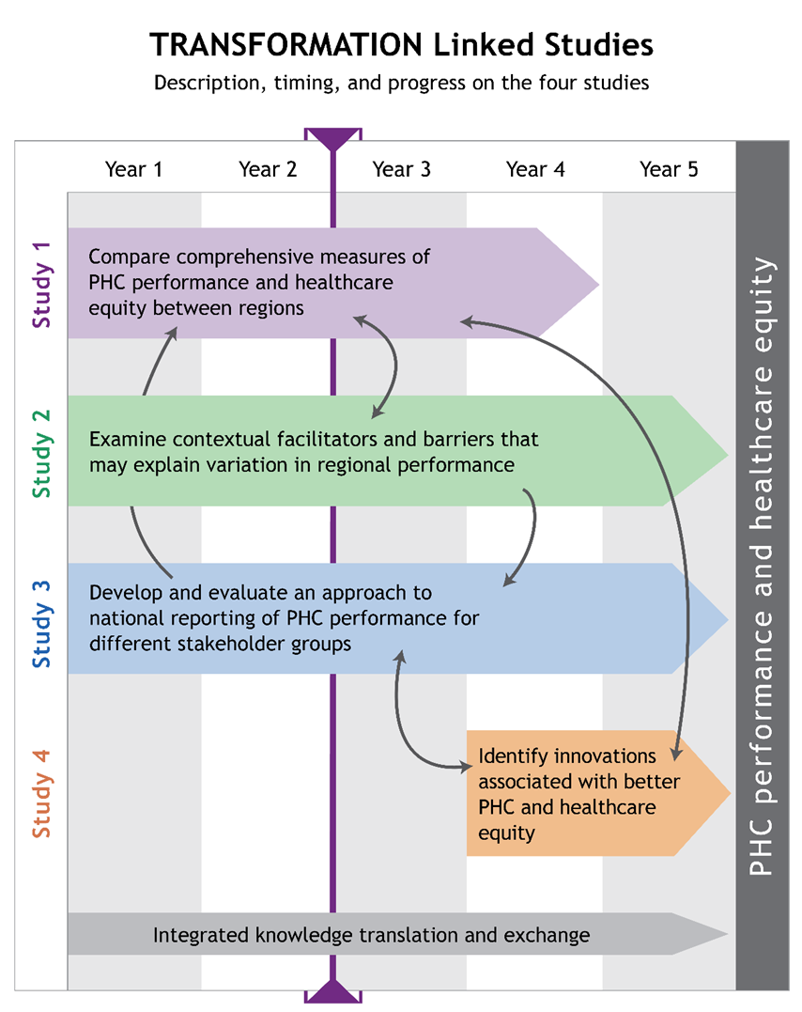
Performance Measurement in Comprehensive Primary Care
Sabrina Wong, Bill Hogg, Fred Burge, Stephanie Blackman
Sabrina.Wong@nursing.ubc.ca
Objective
To compare primary care (PC) performance measures between each of three comparable health regions in British Columbia, Ontario, and Nova Scotia (Fig. 1)
Approach
This work involves collecting data on a suite of practice-based surveys to be administered in 120 comprehensive PC practices. The suite of surveys measure:
Organizational attributes
Provider views and practices
Patient experiences
Team engagement
The linked suite of practice surveys (Fig. 2) will also be linked to health administrative information, such as referrals, lab tests or admissions to hospitals.
In addition to survey administration in both online and scannable paper-based formats, this study is also piloting software for the delivery of automated patient surveys.
Progress
The surveys have been finalized, and each site has completed a pilot test of survey administration. Full data collection began in May of 2015.
Conclusions
Information from the practice-based surveys will be used to inform the work of four nested studies (Fig. 3) with the overarching goal of transforming community-based PC delivery through comprehensive performance measurement and reporting.
The results of these studies will assist health care decision-makers to be better informed by evidence, helping to transform primary care across Canada.
Acknowledgements
This work is funded by:
Practice-Based Surveys
Figure 3.
Figure 1.
Figure 2. Practice survey suite
Online survey emailed to study participants
Completed by person most responsible for operations of practice
Online survey emailed to study participants
Administered to participating family physician / nurse practitioner
Health Administrative Data
Organizational Surveys
Team Functioning Surveys
Patient Surveys
Provider Surveys
Automated Patient Surveys
Offered in both paper and online formats
Completed by all staff within practice (clinicians, allied health professionals, clerical/administrative staff)
Creates a composite score for team functioning
Paper-based and scannable patient survey
Administered to 20 patients in the waiting room of the practice
Questions answered both before and directly after appointment
Piloting a system for automated patient survey administration
Offered through email or by phone
Sent to patients one day after visit
MEASURING AND IMPROVING THE PERFORMANCE OF PRIMARY HEALTH CARE IN CANADA

