Slide 1
Optimizing patient input using deliberative dialogues: lessons learned for enabling patient engagement about primary care performance measurement and reporting
Sabrina T. Wong, Julia M. Langton, Julia Abelson, Fred Burge, Sharon Johnston
November 2016
NAPCRG
MEASURING AND IMPROVING THE PERFORMANCE OF PRIMARY HEALTH CARE IN CANADA

Slide 3
Objective of Deliberative Dialogue
“Improvement is always possible but is difficult to achieve in the absence of actionable information”
To learn from patients about the value of public reporting; Understanding the best way to engage and inform patients and seek their views on public reporting in primary health care
Notes:
A major target of performance measurement and reporting is the general public who have different roles/mechanisms. It is widely thought that the public and patients contribute to quality improvement or can be expected to use data for accountability- voting with their feet towards better care, advocating for better care, voting at the ballot for better value or care, etc ( AHRQ's delineation)
To foster engagement of the public/patients to fulfill these roles we need to understand what data and how presented to match their intended use;
More than a decade ago, the health ministers across Canada agreed to measure the health system’s performance and to report the results to Canadians.
The goal of this agreement was to shape the future of the public health system with governments, providers, and citizens working together.
Despite this commitment, there has been very little reporting to the public about how the primary healthcare system is performing across the country.
Since the original agreement ended in 2014, provinces have been developing new approaches to measure and report on the heath system and primary healthcare in particular. More work is needed to inform these approaches, which is the focus of this study.

Slide 4
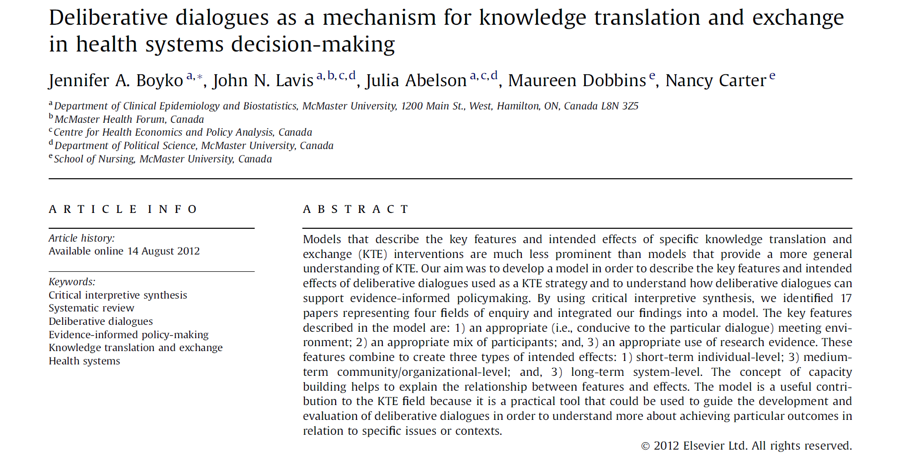
Using deliberative dialogues to engage patients about primary care measurement and reporting
Method for directly involving the relevant stakeholders in value-based discussions about health care systems
Emphasis on transformative discussion informed by different types of evidence
Varied sizes, structures and participant mix
Notes:
- an innovative way to seek public input on important health issues because:
-it allows participants to learn and become informed about the topic before providing their input
-it also allows participants to learn from and interact with each other so that the input provided is shaped by the views that are shared throughout discussions to produce a more collective kind of input
-panels like these also help people work toward common ground on the issues that they are discussing although agreement or consensus among the group is not sought or required

Slide 5
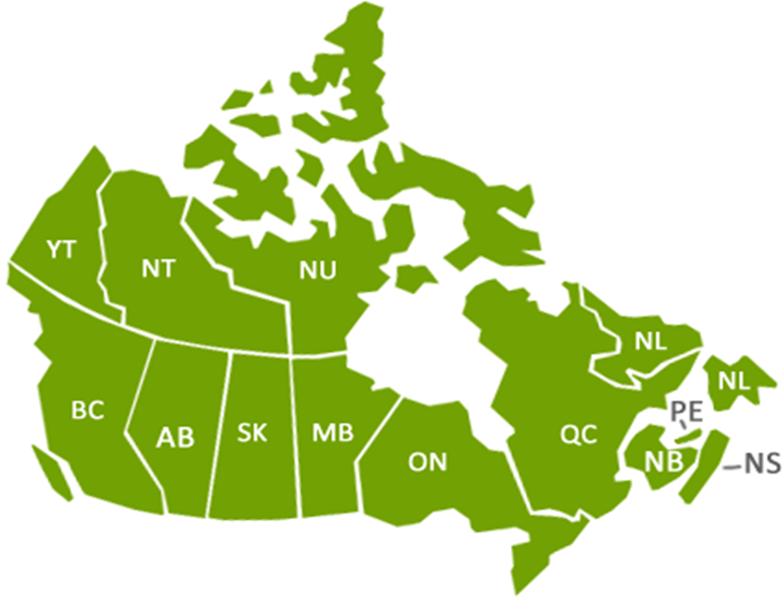
Methods: Dialogue Recruitment
2 deliberative dialogues in each study region (n=6-14 per dialogue)
Less experience/healthy (n=1)
More experience/multi-morbidity (n=1)
Recruitment:
Practice-based survey participants
volunteer/employment opportunity online platform
3
1
2

Slide 6
Methods: Dialogue Structure
Pre-circulated material (relevant background material about the topic, current approaches to performance measurement and reporting)
Structured, facilitated discussion of each element to identify gaps, explore values underpinning different dimensions, and prioritize core dimensions or indicators
Pre- and post- meeting survey to solicit individual feedback on various topics (e.g., proposed dimensions/indicators)

Slide 7
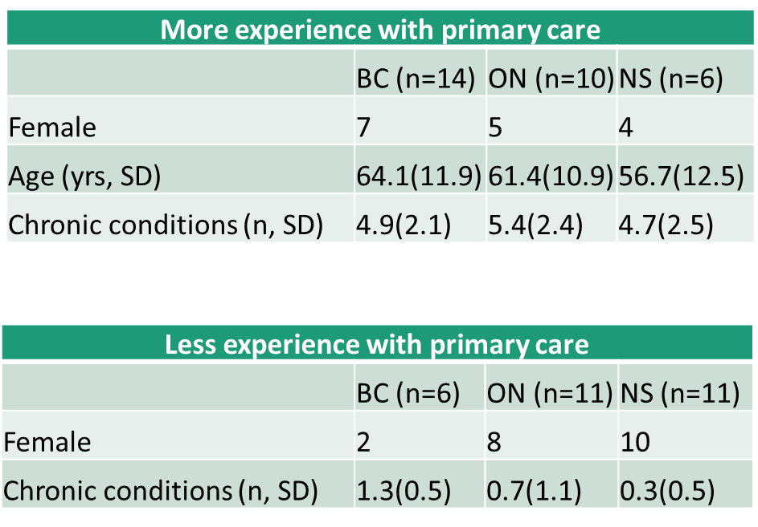
Participants
Notes:
We separated each region’s dialogue by patient experience with the health system assuming that individuals with 3 or more chronic conditions would be more experienced at interacting with the system and might have different perspectives than people whose interactions were more episodic as they were relatively healthy. All of the groups had a mixture of people experienced in navigating the system for them selves or a family member and those who sought out mostly episodic care for acute issues or preventve care such as pap tests.

Slide 8
Methods: Dialogue Content
9:30am | Background to performance measurement and reporting in primary healthcare
10:00 am | Prioritizing performance dimensions and indicators
10:45 am | BREAK
11:00 am | Uses of performance information
12:00 pm | LUNCH
12:45 pm | Reporting formats
2:00 pm | BREAK
2:15 pm | Methods for dissemination
2:30 pm | Summary of key themes from each discussion topic
3:15 pm | Wrap-up: Advice on next steps & final survey
Notes:
Patients who had already participated in our practice based survey and agreed to be contacted again were recruited for the deliberative dialogue sessions. We ran 2 sessions per study site: 1 with healthy patients, 1 with sicker patients. Each DD consisted of 6-10 participants. Participants received a pre-reading package, came to spend the whole day with us, and were provided with a token of appreciation.
Each session started with a presentation by our team content experts with some open discussion to follow. Fro our very first session we could see that people were keen to share their experiences and perspectives and could clearly identify PHC performance elements that were important or of interest to them- but using their own words and they did not recognise their experience or interest as easily in the technical language of the measures we use and currently report, even terms such as patient-centred care. Once these terms were described and linked to their statements, they became much more comfortable with them. Accordingly after our first session in our flow of discussion we mixed in cases to discuss, and created more opportunties for participants to share their own language for PHC performance and then picked up on this to match it to the standard terms we used in the larger research study.
To further help us understand how they might rank different indicators commonly used to evaluate primary care, we provided the participants with paper copies of groups of five and asked them to rate them form very important to report on not important enabling us and partcipants to identify that some did seem more pertinent than others and explain why, enabling us and the participants to see a range of views and even generate debate.

Slide 9
Priorities
There are limited resources to use to measure performance and report back to people
We need to set priorities about which dimensions of primary healthcare performance to focus on and which indicators to use to understand how the system is performing to encourage improvement
How do you know good care when you see it?
Notes:
Participants received in their pre-participation package examples of dimensions and indicators--of over 20 domains of performance and hundreds of indicators. During this section in the DD, participants were told, “Right now in Canada, different provinces measure and report on different domains, even those which measure and report on the same domain such as access or patient satisfaction, use different indicators- access to a family doctor, access in timely fashion, access to phone or email consultation.”
Key lesson learned: Using participant’s words and experiences could identify the domains or specific indicators of interest

Slide 10
Uses of performance information
Consider your roles as a patient/caregiver and as a citizen…
How would you use health system performance information?
What health system performance information would you use?
How should others use primary healthcare system performance information?
Consider people in your community, with certain medical conditions, or someone moving to your community
Notes:
Participants were not used to thinking about PHC performance information as they were more attuned to things like specialist wait times, ER wait times, and the things which make headlines…not primary care We continually redirected them to consider primary health care.
When would you look for information about the health system performance in Primary care- why?
Prompts below if they do not come up with their own uses
Would you use it ….?
To find out how easy it would be to get a new doctor when moving or if a family member was moving to your region?
To know if your doctor was ranked highly in some aspect of care?
To know if people with a specific condition like you were getting good care from your doctor, in a certain region,
To know if certain people not like you were getting good care- people who were homeless, people who could not leave their homes, people with some types of conditions
To judge if the government had done a good job with the health system planning provincially, in your region, what information
Key lessons learned: Relying on participant’s experience alone did not offer a wide range of indicators as participant’s focused on their individual unmet needs; Use of “value” statements rather than ‘measures’ seemed to facilitate patient engagement;

Slide 11
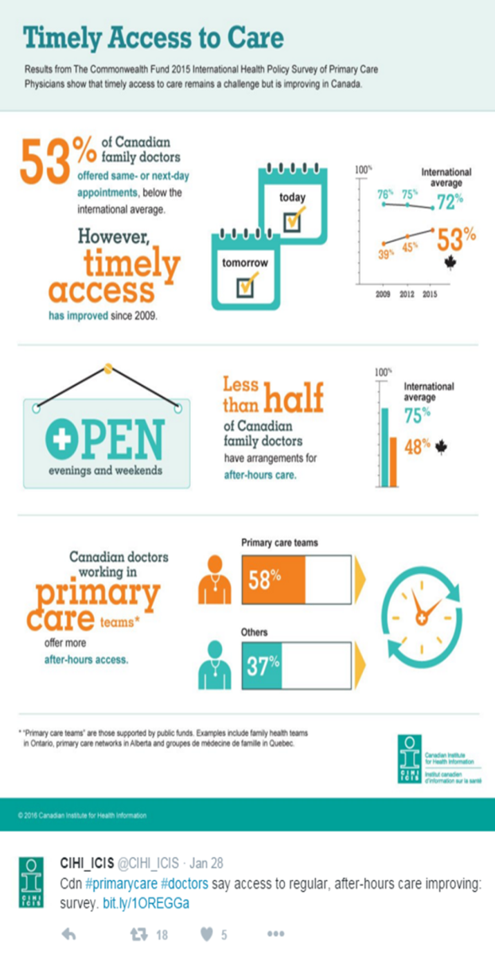
Different formats
Infographics
Hardcopy reports:
pamphlets/ short summaries, long reports
Interactive websites
Notes:
Because primary healthcare reporting is pretty scarce in Canada and people’s awareness of what little reporting there is was even more scarce, we had much of the afternoon devoted to showing examples of public PHC reporting some local and much from leading international examples such as the UK’s GP patient survey reporting on practices and Australia’s Health region reports. Participants could see what public reporting looks like.
Lesson learned: Real-world examples and case studies elicited more discussion than theoretical material;

Slide 12
Key Lessons Learned:
Facilitation of patient engagement:
Using participant’s words/experiences identify the domains or specific indicators of interest;
Use of “value” statements, move away from research/medical jargon;
Real-world examples and case studies elicited more discussion than theoretical material;
Use cases and interactive examples to make abstract concepts concrete,
e.g., your friend is moving to your neighbourhood…
interactive websites and examples of local health system reports
Notes:
Patients can and do distinguish between what is important in their care and what is important to publicly report on—but we in health care have a lot of jargon and technical terms are not easily understood- comprehensiveness, integration, technical quality of care; these become more easily understood when patients' own words and experiences are linked to them or when experience statements or value statements are used to represent these elements rather than actual measures;

Slide 13
Key Lessons learned (con’t):
Setting up and using Deliberative Dialogues:
Worksheets followed by discussion were useful for prioritizing discussion
Separate discussions with healthy patients vs. those with complex conditions worked well
Make sure to collect detailed information about limitations of complex needs participants that might influence their participation
Complex material requires more time commitment, is iterative

