Slide 1
In a sea of data and measures how do we navigate to ensure the right information reaches its destination? Creating a learning system using primary care performance reporting for patients, policy makers and providers
Panel Presentation
Sabrina Wong, Centre for Health Services and Policy Research, UBC
Julia M. Langton, Centre for Health Services and Policy Research, UBC
Sharon Johnston, Bruyere Research Institute & Department of Family Medicine
Julia Abelson, Centre for Health Economics and Policy Analysis, McMaster University
Mary Byrnes, Manager, Primary Health Care Information, CIHI

Slide 2
Presentation outline
Sabrina Wong: project and aims and stakeholder engagement
Julia Langton: measurement and reporting to support a learning health care system
Sharon Johnston: deliberative dialogues to engage patients
Julia Abelson: deliberative dialogues to engage patients
Mary Byrnes: agency perspective, CIHI
Patient perspectives will be discussed throughout
Discussion: Sabrina Wong (discussion moderator??)
Notes:
Need to refine this
In this panel, we will present our methodology for comprehensive practice-based performance measurement and regional reporting. We will discuss best practices and challenges with public primary care performance reporting to different target audiences. Dr Wong will present the overall TRANSFORMATION strategy for comprehensive primary care performance measurement and reporting with a focus on stakeholder consultation and engagement at the heart of the TRANSFORMATION project. Dr Langton will discuss our analytic approach and how it can be harnessed to present information for different audiences and our strategy for the dissemination of information. Dr Johnston and Dr Abelson will discuss the methodology and results from six patient engagement dialogues held in BC, ON and NS where patient and citizen perspectives were sought about which and how primary care performance information should be reported to the public. Ms Byrnes will respond to the progress to date and, highlight how research projects like TRANSFORMATION can align with the work done by national agencies, such as CIHI, and the stakeholders whom they serve. Patient perspectives will be demonstrated by showing preliminary results from our patient engagement work.

Slide 3
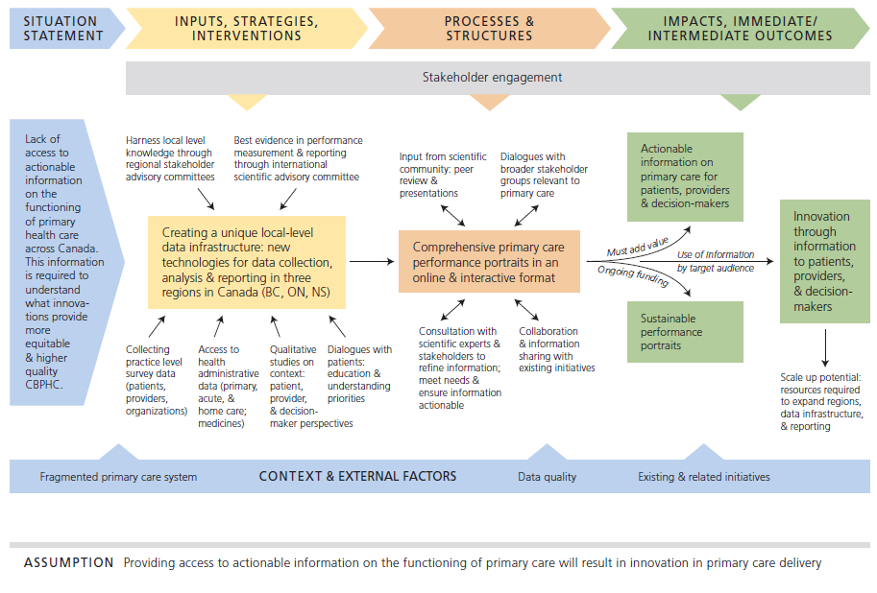
Transforming primary care through performance measurement & reporting
Notes:
Stronger primary care systems are associated with reduced costs and better health outcomes. Better and more data sources are increasingly available for primary care including national, provincial and practice-based survey data, EMR data, and routinely collected health data. We need to develop an effective system to use these data to monitor and improve the performance of primary health care systems across Canada. With hundreds of different measures available, it is essential to get the right information to the appropriate audience. Research suggests that different audiences have an interest in different types and amount of information. The aim of the TRANSFORMATION team grant is to develop an actionable regional-level primary care information system for providers, policy makers and patients across Canada. We have advanced the science and methodology of performance measurement and reporting in primary care by developing a comprehensive data infrastructure that includes patient, provider and primary care organization surveys and administrative claims data.
Note: goal was regional-level reporting

Slide 4
Meaningful engagement of multiple stakeholders to ensure success [develop figure]
Aim | Strategy
Harness local knowledge | Constant feedback loops with those at the coal face (e.g., local advisory committee with administrators, patients, and clinicians from the local area)
Best evidence in measurement and reporting | International scientific advisory committee
Meet stakeholder need | Dialogues, case studies, focus groups with decision-makers, patients, clinicians
Align with existing initiatives | Constant feedback loops
Notes:
Suggest we develop a figure to show the approach.
This would “hash” out the parts of the logic model focused on patient engagement.

Slide 5
Creating a learning health care system
What works to accelerate improvements in local care? | What doesn’t?
Locally relevant information about health care organisations | National or state level information
Comparable performance information in relation to peers and after accounting for differences between organisations in patients | Just numbers, no comparisons, no accounting for different types of patients served
Nationally consistent – lots of comparisons | Not comparable information, too few comparisons
Impartial – independent, arms length | Reporting on oneself
Engagement: Review the data to benchmark with peer groups. Be open to learning from colleagues on how to achieve best performance, and be generous in sharing your innovations with the system.
Notes:
We are attempting to adhere to these principles about what works to accelerate improvements in health care.
Big focus on ENGAEMENT (as mentioned by Sabrina)

Slide 6
What works: Evidence from the UK review of primary care performance measurement and reporting
Clarity of purpose and audience and market research
Should be explicit
Iterative and ongoing work to examine factors that increase usage of performance information
Indicators for the public
Ratings might be better than “indicators”
Scope to raise awareness among the public of the information that is already available
Thought should be given to a range of complementary methods for displaying information, as well as online resources. Such activity may be more effective around a ‘trigger point’, such as someone moving house.
Indicators for professionals
The term ‘scorecard’ is divisive - recommend avoiding this terminology if a key purpose is for improvement.
There appears to be low awareness, among GPs in particular, of the main websites currently containing quality indicators for general practices. We recommend consolidation of the existing websites and additional market research and engagement to understand how those working in general practice make use of online information.
Composite scores and population grouping
Advise against composite measures for a public or professional audience.
We suggest users should be able to select from a full menu of indicators by various groupings. Such an approach could readily be seen as responsive to the needs and aspirations of patients themselves, and thus offer additional credibility with the public. Such groupings could include age groups or other population groupings, or groupings by clinical condition or service.
Selection could also include comparison with similar practices, allowing in part for context.
Notes:
Busy slide, we can cut down.
There are key ways to improve primary care performance measurement and reporting to support a multi-stakeholder learning system. There is a need to strike the balance between comprehensive, all-inclusive information systems with those that present the information of most use to respective end-users. Indeed, the quality of information alone will not guarantee uptake of information and substantial resources are required to optimize the presentation and communication of information. Experiences from other jurisdictions such as the UK suggest it is important to engage in market research for different audiences and consolidate existing information systems rather than re-inventing the wheel. Since primary care performance measurement is relatively new in Canada, we have an opportunity to target efforts and work together across the country towards the goal of an actionable primary care performance measurement and reporting system that meets the needs of different audiences.
UK setting is different in that they have lots of sources of primary care performance information and actually need to reduce duplication and streamline (vs. Canada where little information is available)

Slide 7
Our questions to stakeholders: learning how best to publicly report assessments of the Canadian primary healthcare system
Prioritizing dimensions and indicators: lots of information, limited resources
Reporting format? hardcopy vs. online; summaries vs. detail
Level of reporting? practice-level (practice vs. others); regional-level (local area vs. others)
Utility of patient subgroups? subgroups by age, disease, health status
Mode of dissemination? best way to get this information to stakeholders
Notes:
These have been ongoing questions we have posed to stakeholders via various mechanisms…..

Slide 8
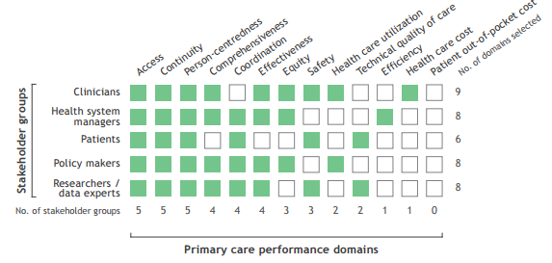
Preliminary findings: what they said
Utility in both regional and practice-level reporting
Access, continuity, person-centredness as starting points
Notes:
In the context of limited resources, we hoped this engagement would help refine our goals but in reality, we found we had MORE to do!!

Slide 9
Notes:
Rating excersise

